Slide 1
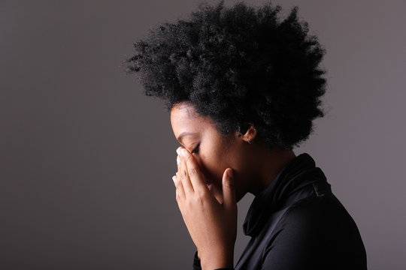
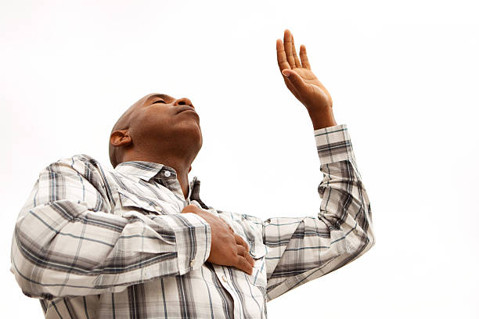
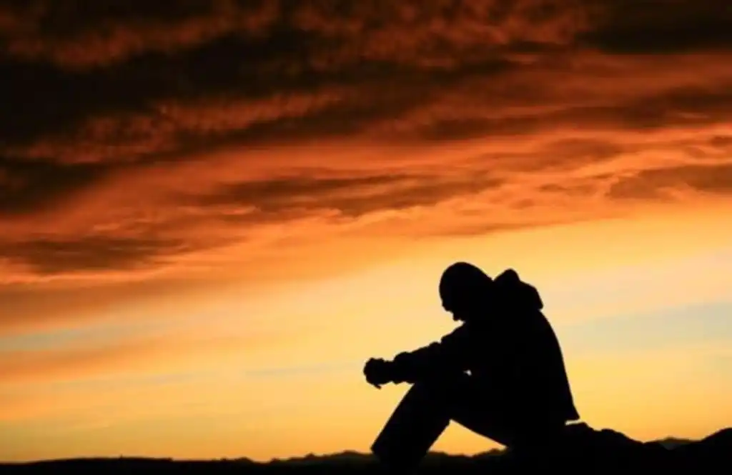

Mount Zion Glendale – Bible Study 3/26/24
Brokenhearted to Praise
Psalms 51 Job 1: 20-22

Slide 2
What does it mean to be “Brokenhearted?”
Webster’s Definition – Overwhelmed by grief or disappointment, full of sorrow, not able to function
correctly
The compound word brokenhearted appears twice in the KJV version (Isaiah 61:1 and Luke 4:16-18)
(**Note the same scripture). It lets us know that GOD cares about the Brokenhearted……
Hebrew and Greek meanings are very similar:
Broken -----
Greek - suntribo – to crush completely, to shatter into pieces
Hebrew – shawbar – to burst, to break off, to break down, to break in pieces, crush, destroy
Heart -----
Greek - kardia – (Fig.) thoughts or feelings , mind, the middle
Hebrew – leb – (Fig.) – very wide feelings, the will and intellect, the center of everything, courage, friendliness, regard for things, etc.

Slide 3
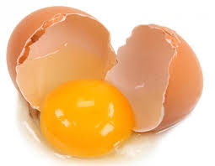
Brokenhearted /Brokenness is what GOD uses sometime to:
Grow you
Get something from you
Position you
Take something out of you
Put something in you
Etc, Etc.
Without it, often times these things could not be accomplished. Our brokenness is not to highlight an issue, it’s to get us to see GOD at another level. 2nd Corinthians 12:9
Sometimes we have to be broken for the Light to come in. We are all sealed up in some areas of our lives that GOD wants to improve upon.
The move of the Holy Spirit in our lives cannot happen sometimes until we are “cracked.”
An Egg is only useful when its shell has been cracked!!!

Slide 4
When brokenness or being brokenhearted enters our space, it enters in 1 of 2 ways:
GOD allows it. You have not done anything wrong but GOD is putting you thru something involving…
  Spouse,
  child,
  Friend,
  Family member,
  Boss,
  Coworker,
  Neighbor,
  church ,
  church member, etc.
Your personal sin – You are totally broken for something you have done. You have repented but you just cannot believe you did what you did and it leaves you broken.
Alert Alert – When this happens, we must turn to GOD first or other things will set in. When we are hurt, we often want to get an opinion or advice first. There is nothing wrong with that, but we have to make sure we consult GOD’s word first before we move forward (Lean on - Proverbs 3:5-7)
Anger Sin Bitterness
Blame Despair Depression
Callus Revenge

Slide 5

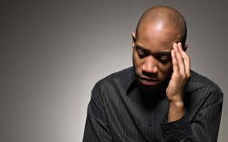
Often times in life, we are taught and advised more on what we have to do to succeed in life rather than how we are taught to effectively deal with life’s challenges as GOD would have us to.
How to do we FALL Up?!!!
Instead of FALLING DOWN…..
Our Brokenness

Slide 6
Job is an example of Brokenness that was a result of what GOD allowed.
Job 1 :7- 12
GOD gave Satan permission to touch all he had except him personally
Job 1:13-19
4 tragedies hit Job’s life all in 1 day
      Oxes fell to Sabeans and servants killed
      Fire burned up the sheep and the servants
      Chaldeans killed the servants and took the camels
      Wind blew down the house and killed his children
So how did Job respond? He is an example for us today in how to respond in these type circumstances.
Job 1:20 – 22
He did not say, “Why?,” did not blame GOD, the Sabeans, the Chaldeans, the fire or the wind

Slide 7
What did he do:
He showed his deep state of mourning by standing up, renting (tearing) his clothing and shaving his head and falling to the ground:
    Worshipped GOD
    Recognized his position
    Recognized who GOD was
    Blessed the name of the LORD
WOW WOW !!!!!!!
2 Afflictions - Job 2: 6 -10
1. Satan strikes him with boils all over his body
2. His Wife criticizes him but he does not sin with his lips!!!!!!!!!!!!
WOW WOW !!!!!!!

Slide 8
We know Job went thru severe situations but because of his integrity and his solid foundation in the Lord, look at what happened!!!!!
Job : 42: 12- 15
___________________________________________________________________________________________
Sometimes our Brokenness is caused by our sin
In Psalm 51 David, in his deep regret of what happened with Bathsheba and his devious scheme. What if he had just admitted his sin? If we don’t admit it and try to cover it up, one sin can lead to a slew of transgressions.
Brokenness can grow us if we are truly sorrowful
V. 1-6
    Brings us back to a full reliance on God’s grace and mercy alone.
Stedfast Love – Hebrew – Hesed -mercy, kindness, goodness, faithfulness and loyalty.
    Gives us a constant desire to live a purified life.
    Brings a humility that allows me to admit when I am wrong.
    Allows us to understand and admit the true and full impact of our sin.
    Makes us recognize who we truly are
    Helps us realize things GOD desires of us

Slide 9
Psalms 51 :
V 9 – 12
    Helps reveal in us the shame before GOD and the need to change
    We are able to reveal what we see in the mirror to GOD and what we need
    Makes it obvious to us that we need the HOLY SPIRIT in our lives
    It makes us Joyful that we know the LORD
  V 16 – 17
  We discern that there is nothing we can do to make ourselves right with GOD. GOD will and does reject just going through the motions of religious offerings, but God will never reject a truly broken, contrite, repentant heart. If you come to Him with that heart, He will never reject you, never! What GOD wanted from David and us was and is our heart, broken and contrite over sin;
  not just going thru the motions ( Galatians 6:7-8).
  Sometimes we will not discover GOD is all we need until GOD is all we have. – BROKENESS CAN PUT US THERE –

Slide 10
Here are some scriptures that can help us………….
Jeremiah 29:11
Psalms 34: 18-19
Psalms 71:20
Colossians 1: 16-17
Psalms 46: 1
1st Peter 4:12
Psalms 147: 3
Brokenhearted/Brokenness
This can be a true pathway to Transformation
in your life

