Slide 1

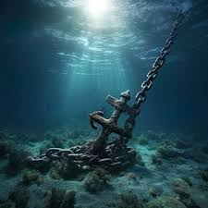
Proverbs 21:16
Are you Wandering or Anchored??
Minister Martin Jones

Slide 2
Wandering
Taah (Hebrew) – to vacillate, reel about, go astray
Perierchomai (Greek) – veer, wander about
Webster – Adjective – Traveling aimlessly from place to place
Itinerant – A person who travels from place to place
Latin – Where we get the word Itinerary
Anchored
Webster – Secured firmly in position, providing a firm foundation
Sometimes different situations in life cause us to “ Wander”

Slide 3


We have so many different lanes of life that can cause us to Wander…..
I
M
P
A
C
T
SELF
SELF
Etc………….

Slide 4
Family, as we are growing in our Christian Faith, we have to be careful not to wander, but stay anchored. It is so so easy for us to do.
So what is Wandering?
Any action or thought that leads to unGODliness, which takes you away from GOD’s direction and purpose for your life. This results in a falling away into sinful behaviors; in some cases from one thing to another.
Wandering is dangerous. It blocks GOD’s blessings and can bring judgement.
Children of Israel – WOW - Wandering caused wandering. Because of their unbelief and disobedience, what should have taken 11 days took 40 years!
Deuteronomy 1:2, Numbers 14: 26-38

Slide 5
Wandering (Results)
Proverbs 21:16
2nd Chronicles 15:1-6 – Focus on verses 3, 5 and 6
Romans 1:18 – 32
We must keep in mind:
John 10:10 -- Remember who the enemy is …..
1st Peter 5: 8 -10 -- Satan’s goal but GOD’s purpose…..
Jeremiah 17: 9 -- Watch out for your heart….
Romans 5:1-6 -- There are some benefits to enduring…..
Romans 7: 14 -25 -- Our carnality is strong….
1st Peter 4:12 -- Don’t be surprised….
James 1: 2-4 -- Be joyous in our circumstances….
James 1: 12-15 – Sometimes its us….

Slide 6
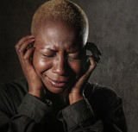
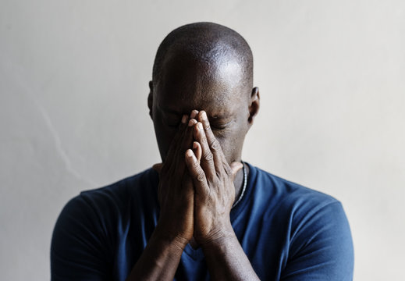
What causes us to Wander?
Remember when we start to say “I think” and “I want” etc.,
we may be headed down a path of wandering.
Fear
Hurt
Lack of Patience
Lack of Humility
Someone getting on your last nerve
Faith waver
Trials
Loss of Loved One
Temptation
The List goes on.......
_________________
_________________
_________________
_________________
_________________
_________________

Slide 7
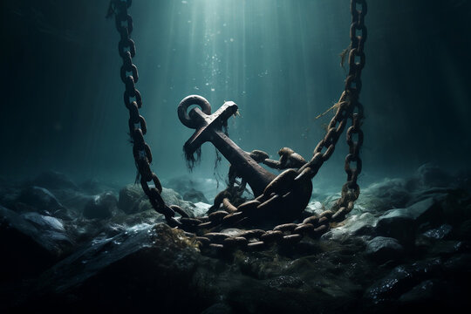
How do we stay Anchored?
We must remember Family – “It’s not about you.”
Colossians 1:16
Quotes from Rick Warren’s book, “A purpose driven Life” – Chapter 1
“The Purpose of your life is far greater than your own personal fulfillment, your peace of mind, or even your happiness. It is far greater than your family, your career or even your wildest dreams and ambitions. If you want to know why you were placed on this planet, you must begin with GOD. You were born by his purpose and for his purpose.”
“It is only in GOD that we discover our origin, our identity, our meaning, our purpose, our significance and our destiny. Every other path leads to a dead end”

Slide 8
How do we stay Anchored?
Luke 9:23 – 27 – Daily carrying out
Proverbs 3:7 - Don’t be too wise for your own good
Ephesians 6:12 – Remember who the battle is against
Colossians 3: 1-2 – GODLY views
Proverbs 13:20 – Be careful who you associate with. (But there is a balance. Sometimes you are an example for others to see Christ. Matt. 5:16)
Hebrews 2:1-4 – Don’t neglect the message through Jesus Christ
James 5:19 20 - Help restore someone else

Slide 9
Stay Connected with the right people
Prayer and Fasting
Church
Bible Study
Personal Study
Devotions
Praise
Worship
Get involved in Ministry
2nd Timothy 2:15
John 14:26

