Slide 1
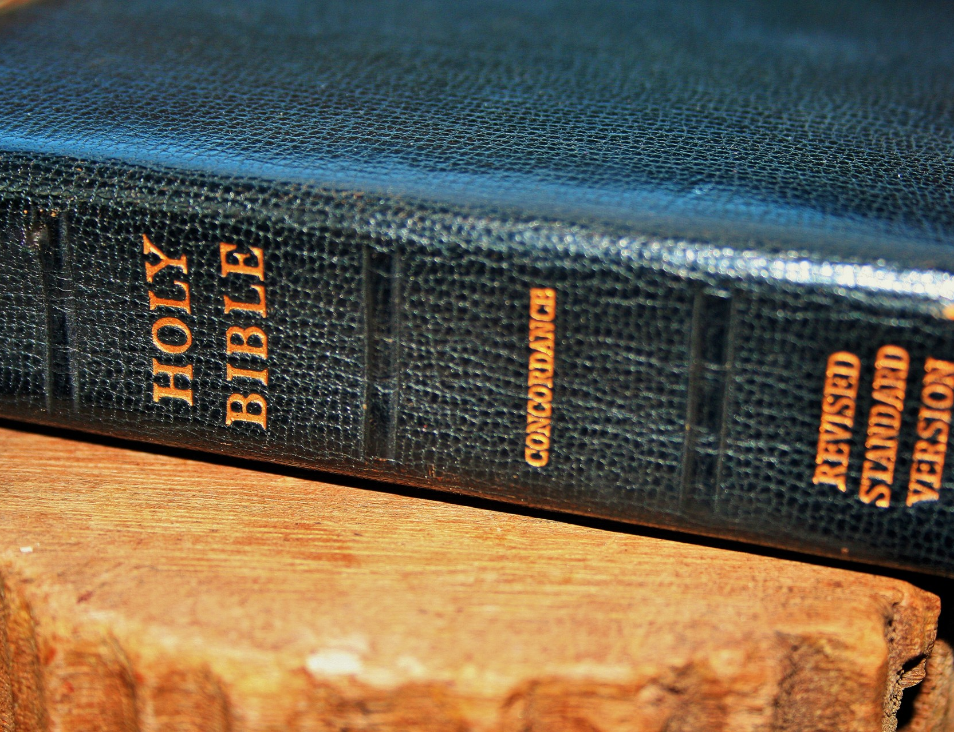
What is Faith?
Hebrews 11:1-3
Min. Cameron Foster
Mt. Zion Missionary Baptist Church
Bible Study
May 1, 2024

Slide 2
Scripture Text
Hebrews 11:1-3
Hebrews 11:1 – Now Faith is the substance of things hoped for, the evidence of things not seen
Hebrews 11:2 – For by it the elders obtained a good report.
Hebrews 11:3 – Through faith we understand that the worlds were framed by the word of God, so that things which are seen were not made of things which do not appear.

Slide 3
Jesus is the Source of Our Faith
Jesus is the source of our faith because Jesus is the Son of God.
Jesus gives us living water by which we can be saved through grace. That grace and mercy are given to us by God.

Slide 4
Jesus is our Source of Faith
Faith is from God (Ephesians 2:8). God gave His one and only Son to atone for our sins. What a precious gift! We don't deserve this most extravagant gift; yet God loves us so much that He decided to give His Son so we might live (John 3:16)

Slide 5
Jesus is the Source of Our Faith
Jesus was born in humble surroundings, lived a life of servanthood, preached to thousands, healed the sick , followed the will of His Father, and gave the ultimate sacrifice for us.
Hearing or reading the word of God can bring us closer to Him. Through sharing fellowship, in good and difficult times, we can call Jesus and have faith He is with us.

Slide 6
What is a profession of Faith?
Simply put – A profession of faith is publicly declaring your faith journey with Christ. This can happen through baptism, an outward sign of an inward change.
Baptism
Being put in the water. Here we mirror Christ's death and burial. In the same way our sinful nature is killed and buried.
Being pulled out of the water – Represents the resurrection that all believer's experience. We have put to death our old selves and experience new life in Christ.

Slide 7
"Walk by Faith, Not by Sight"
2nd Corinthians (5:7) - For if we walk by faith, not by sight
Paul explains to the Corinthians that even though this temporary realm we live in may seem like a physical barrier between us and God, through Christ, we are able to have fellowship with God.
John 20:29 – Jesus saith unto Thomas, because thou hast seen me, thou has believed: blessed are they that have not seen, and yet have believed.

Slide 8
"Walk by Faith, Not by Sight"
1st Peter 1:8 – Whom having not seen, ye love; in whom, though now ye see him not, yet believing, ye rejoice with joy unspeakable and full of glory.
We see the same evidence that there is more truth than meet the eye. Though none us has physically seen God, we know that God is real.

Slide 9
Faith Without Works is Dead
James 2:26 – For as the body without the spirit is dead, so faith without works is dead also.
James affirms that deeds (or actions) are the byproduct of a living faith. Works do not justify us or makes us righteous before God nor are they the means to salvation.
Rather, our deeds are the fruit that grows from one who is obedient to God's commands and transformed by His grace.

Slide 10
Key Bible Verses About Faith
Hebrews 11:1- Now FAITH is the substance of things hoped for, the evidence of things not seen.
Hebrews 11:6 - But without faith it is impossible to please him: for he that cometh to God must believe that he is, and he is a rewarder of them that diligently seek him.

Slide 11
Key Bible Verses about Faith
Ephesians 2:8-9
8 – For by grace are ye saved through faith; and that not of yourselves: it is the gift of God.
9 – Not of works, lest any man should boast.

Slide 12
Key Bible Verses about Faith
Proverbs 3:5-6
5 – Trust in the Lord with all thine heart; and lean not unto thine own understanding.
6 – In all thy ways acknowledge him, and he shall direct thy paths.

Slide 13
Key Verses about Faith
Romans 10:17 – So faith cometh by hearing and hearing by the word of God.
Luke 1:37 – For nothing shall be impossible.

Slide 14
Key Bible Verses about Faith
Romans 5:1-2
1 – Therefore being justified by faith, we have peace with God through our Lord Jesus Christ.
2 – By whom also we have access by faith into grace wherein we stand and rejoice in hope of the glory of God

