Slide 1
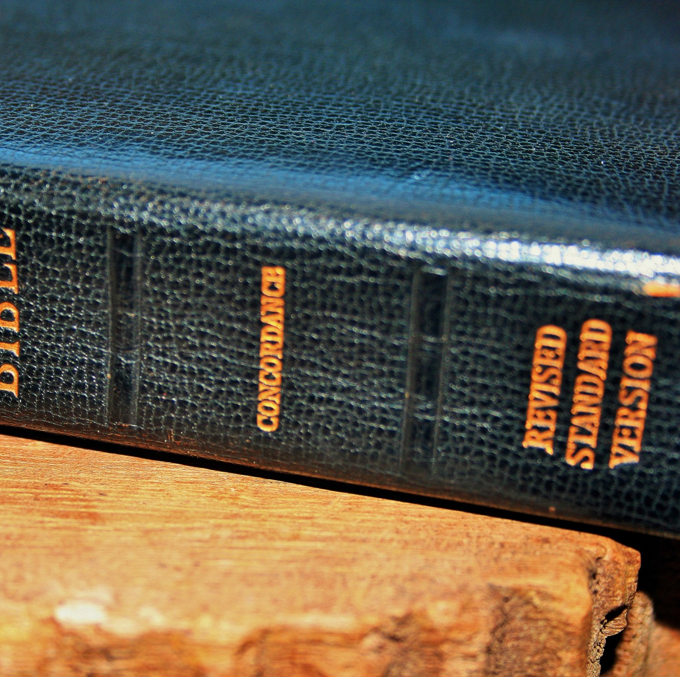
Joy Unspeakable
1st Peter
Min.Cameron Foster
Mt. Zion Missionary Baptist Church
Bible Study
May 8, 2024

Slide 2
Scripture Text
1st Peter 1: 7-9
7: That the trial of your faith, being much more precious than of gold that perisheth, though it be tried with fire might be found unto praise and honor and glory at the appearing of Christ.
8: Whom having not seen, ye love; in whom, though now ye see him not, yet believing, ye rejoice with joy unspeakable and full of glory.
9: Receiving the end of your faith, even the salvation of your souls.

Slide 3
Joy Unspeakable
The Apostle Peter tells us that we should rejoice with "joy unspeakable and full of glory" because our reward for our faith in Jesus Christ is the salvation at His appearing.
As in every Epistle, Peter is writing to those who have been filled with the Holy Spirit.
Peter, an Apostle of Jesus Christ, to the strangers scattered throughout Pontus, Galatia, Cappadocia, Asia and Bithynia,
Elect according to the foreknowledge of God the father, through sanctification of the spirit, unto obedience and sprinkling of blood of Jesus Christ: Grace unto you, and peace, be multiplied. (1Peter 1:1-2)

Slide 4
Joy Unspeakable
In 1st Peter 1:6- Wherein ye greatly rejoice though now for a season, if need be, ye are in heaviness through manifold temptations:
Manifold = Many
In James 1:2 – My brethren, count it all joy when ye fall into, divers temptations.
In other words, we're to jump-up, spring-up for joy no matter what our emotional state. " We can't let our trials get us down." In fact, Peter tells us that because of our faith, we will be refined as pure gold.

Slide 5
Joy Unspeakable
Your trials will show that your faith is genuine. It is being tested as fire tests and purifies gold- though your faith is more precious than mere gold.
Yes, indeed trial of our faith, through heat means that our impurities are being removed by the Holy Spirit.
We need to jump for joy when this happens or that happens instead of having a pity party.
Our trials should never stop us from rejoicing.

Slide 6
Joy Unspeakable
First, joy is rooted in Christ and what He has done for us. Paul ask the Philippians to complete his joy by living in a way that reflects the mindset of Christ Himself .Paul describes how He was fully God. Christ set aside the glories of heaven to become a servant by taking on flesh and living among us.
He lived the life of perfect obedience that we could never live and willingly gave His life on the cross for our sins.

Slide 7
Joy Unspeakable
Second, unspeakable joy is rooted in the gospel as in sharing and spreading the gospel.
Philippians 1:25 – Convinced of this, I know that I will remain, and I will continue with you all of you for your progress and joy in faith.
Philippians 1:12 - But I would ye should understand, brethren, that the things which happened unto me have fallen out rather unto the furtherance of the gospel.

Slide 8
Key Verses about Joy
Psalm 43:4 – Then will I go unto the altar of God, unto God my exceeding joy yea, upon the harp will I praise thee, O God my God.
Romans 12:12- Rejoicing in hope, patient in tribulation, continuing in constant prayer
Romans 15:13- Now the God of hope fill you with all joy and peace in believing that ye may abound in hope through the power of the Holy Ghost.

Slide 9
Key Verses about Joy
Philippians 4:4 – Rejoice in the Lord alway: and again, I say Rejoice.
1st Peter 1:8 - Whom, having not seen, ye love; in whom though now ye see him not, yet believing , ye rejoice with joy unspeakable and full of glory.

Slide 10
Key Verses about Joy
1st Peter 4:13- But rejoice, inasmuch as ye are partakers of Christ's sufferings; that, when his glory shall be revealed ye may be glad also with exceeding joy.

