Slide 1
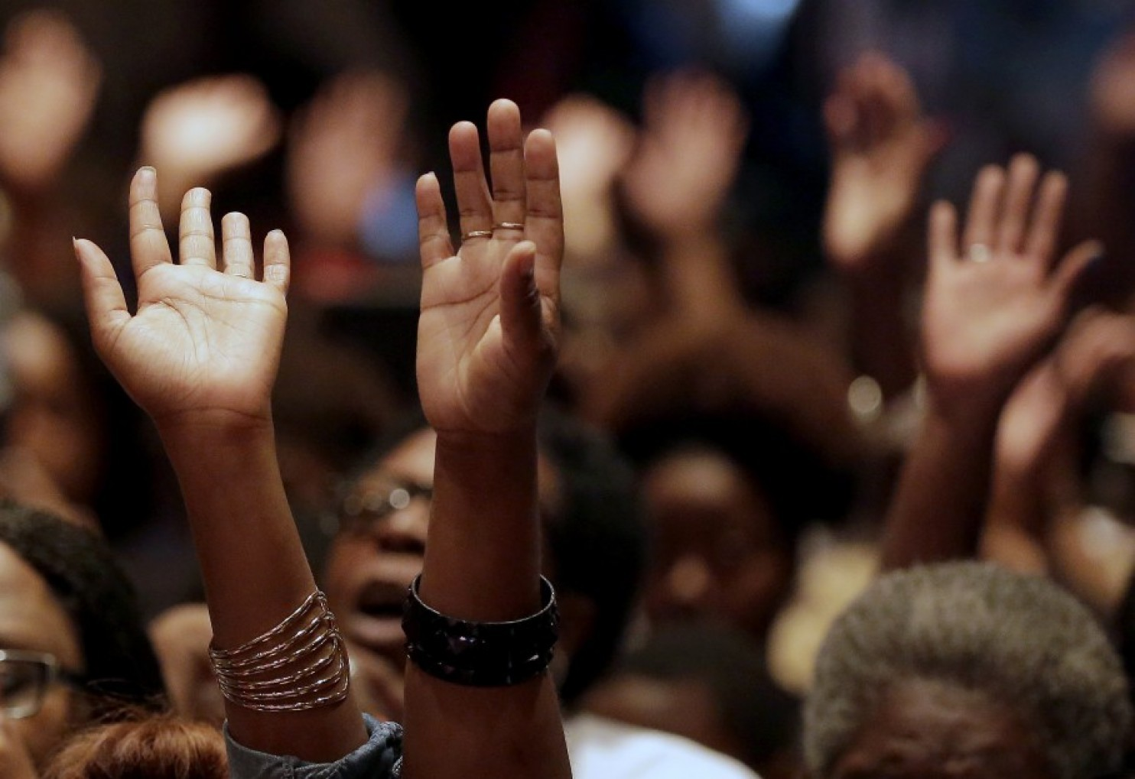

How to “ Be in” your Purpose
Colossians 1:16
Min. martin Jones

Slide 2

This is a very broad topic. Tonight we are going to study just some foundational steps.......................
The very very 1st and most important step to being in your purpose is to Keep deep in your spirit.
“Its not about you” ----- It’s about GOD’S Kingdom
(First Chapter of “A purpose Driven life”) Colossians 1:16
What did our youth sing to us - “I Belong to GOD”
Creation cannot tell the Creator what its purpose is……………………….
Kingdom Mindset is critical
This focal point is so important - Why????
We know family. Of course we are not born to think the way we should to be in our purpose….
Proverbs 16:9
Romans 7: 14- 25
Jeremiah 17:9
Matthew 26:41:
Romans 8:5-8
Galatians 5: 16 -21

Slide 3

We, Family, have to make a conscious decision to take “us” out of the picture. This is very difficult to do at times
Mark 8:34
Ephesians 4: 22-24
Galatians 5: 16-17
Isaiah 55:9
What are 3 things in your life that get in the way of your following GOD and not yourself
1.
2.
3.
Is that your focus?
Don’t let your emotions over rule – Purpose
Our Purpose in life may lead us to be uncomfortable – a Seed has a purpose but it must be planted……
Pray for Guidance in these areas – Philippians 4:6-7

Slide 4
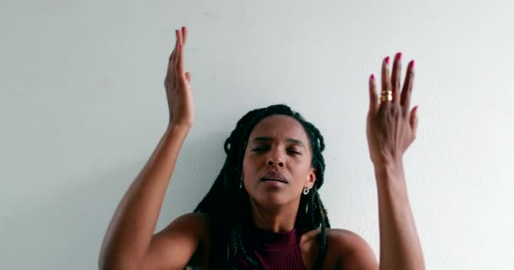
By being a child of GOD and consistently striving to live in His presence, He will guide, direct and prepare us for the purpose He has for our lives. We have to stay plugged in.
Jeremiah 29:11 Psalms 119:105
Isaiah 30:21
Psalms 32:8
Proverbs 19:21
GOD has a plan for us and sometimes we are in our purpose and don’t know it.
We are a part of a bigger picture. Have you ever had someone come up to you and say “Thank you”. You really helped when etc…etc…etc……………………………………………………………….
You had no idea the Holy Spirit was using you. Family, that is being in GOD’s presence for His Purpose.
Think on that. That has probably happened to you in your life.
Remember it’s his Purpose not your own

Slide 5

Excerpt from - Tony Evans
When you truly embrace the principle of Psalm 46:10
“Be still, and know that I am God.”
You will experience the abundant joy that Christ has promised you. Because you will no longer be spending your energy trying to see if this plan will work or if this relationship will work or if this job will work or if this path will work because when you know that God is God (and you seek to get close to Him), He will show you your path, your job, your mate, your relationships, meaning and purpose.
___________________________________________________________________________________________________
So family, you may ask, “How will we know that we are in our purpose?”
*Are you in His presence or is it your agenda? (This takes a lot of effort.)
Prayer
Study
Church
Bible Study
Accountability etc, etc, etc……….
*Rather smooth or rocky, are you seeing the move of the Holy spirit around
you?

Slide 6
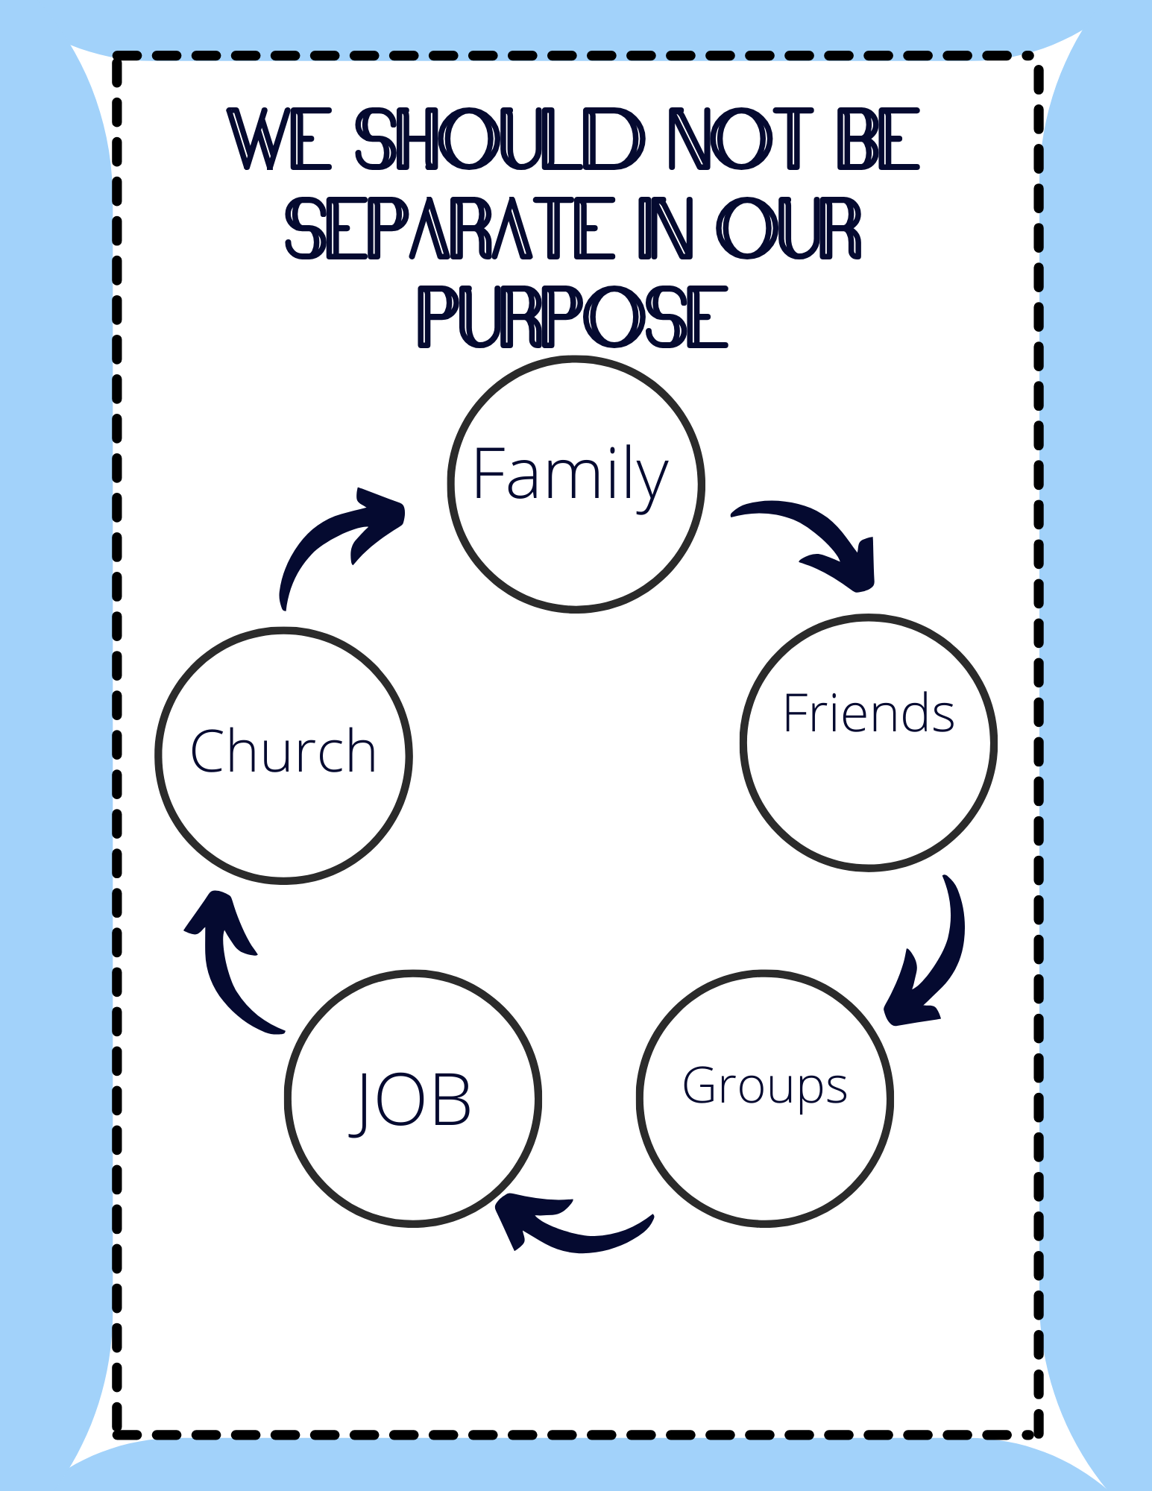

Slide 7


