Slide 1


Slide 2
Family – Grace is a word we can focus on for an eternity, but we are going to take a bite out of the study of Grace, so we don’t miss it as we grow in Christ.
We all have a lot going on and there is a lot going on around us ……
Sickness
Family Issues
Finances
Marriage issues
Bereavement
Job
Hate
Lies
Politics
Wars
Violence
etc etc….
We can sometimes let our circumstances drown out or cloud our understanding of GOD’s promises. We can sometimes try to use a human solution in place of Holy Spirit ( Biblical promises). We must remember that we have a relationship with Jesus Christ….. Lamentations 3:21-24

Slide 3

Sometimes its easy to under value what we do not see – GOD’s Grace is always there …….
We are all challenged in so many different ways, family, and it seems that worldliness (idolatry) is pre-eminent……Galatians 6:8-9
We must keep the main thing the main thing, through our challenges, mental thoughts, tough spaces in life and even in this ridiculous political environment we are eroding into………
Stay focused on the Word of GOD. Satan has a plan (1st Peter 5:8) but GOD has the ultimate plan John 10:10.
Don’t be surprised – 2nd Peter 4:12 -13
The things GOD allows us to go through are to His Glory and your growth
We want to focus on 2 Concepts…….
When GOD says “NO” - Understand his Grace is sufficient in dark times….. 2nd Corinthians 12:9
Continue to grow in it ……. 2nd Peter 3 :18

Slide 4
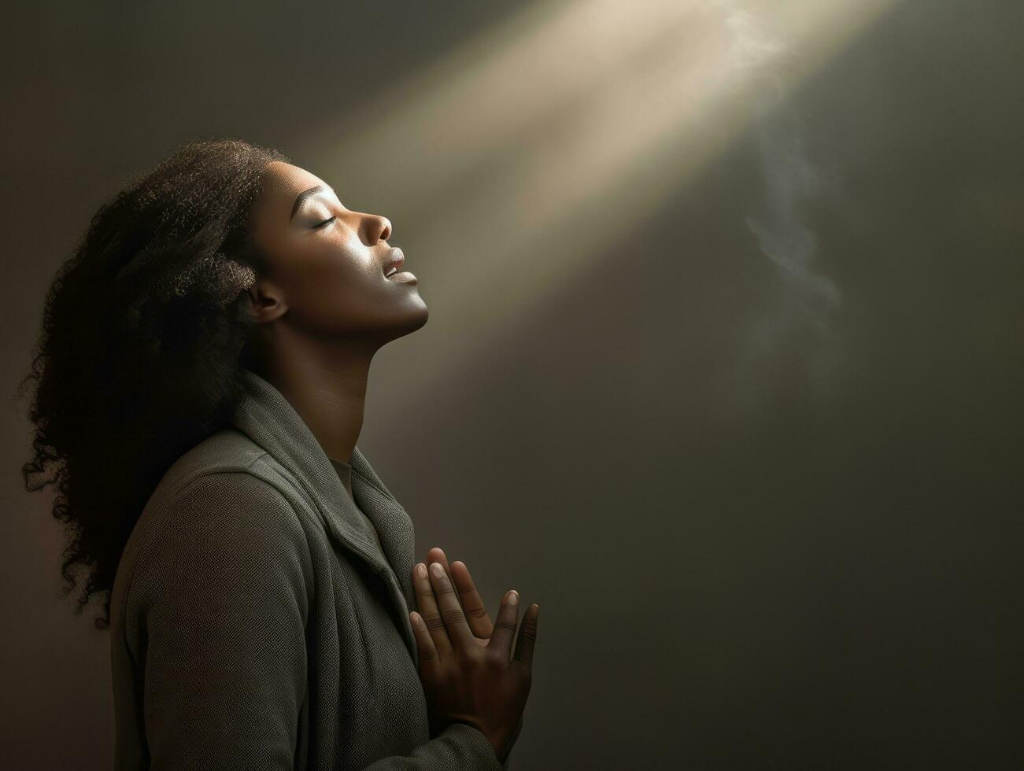
Grace
Grace is through which Salvation is accomplished. Ephesians 2: 8-9…….John 1:16-17
Romans 11:6
Unmerited Favor
Expression of GOD’s goodness towards the undeserving
The inexhaustible supply of GOD’s goodness in doing for us what we cannot do for ourselves
All that GOD is free to do for us independent of us
Why do we need Grace?? ???I It was really bad news for the Human race
Romans 3:23 – The penalty for sin is - Death, Justice, Wrath
Ephesians 2:5 – We were dead
Ephesians 2:4 - GOD is rich in Mercy and Love
V4 – “But GOD “
John 3:16 – the “so love”

Slide 5

Reminder, the Law is just like a mirror; it points out sin to us. It cannot save us but it lets us know we deserve the penalty of sin. Romans 3:20
Sometimes we promote as good old Christian folk - unbelievers to be saved by Grace but let’s be changed by the law – Ouch – Ouch
So how did GOD resolve the problem???????
GRACE
Death
Justice LOVE & MERCY
Romans 6:14
Wrath
But remember Galatians 6:7-8….

Slide 6
2nd Corinthians 12:9
When GOD says “No” -Grace is enough in dark times
Excerpt from Mr. and Mrs. Marriage Devotional July 8th
“Our Gift of Salvation does not mean the elimination of pain. In this life we are guaranteed to experience troubles. We will face hardships and many will face persecution. This is not an indication of lack of love or care from GOD. On the contrary, we are sharing in the suffering of Christ, just as we will share in his eternal Glory, GOD has made us co-heirs of His kingdom with Christ Jesus and that means that we each have our own cross to bear. It is by His kindness that we have been called to shine the light of Jesus in the darkness; and with the darkness comes deep depravity.
Corruption and wickedness should not intimidate us or silence our message because we have a promise from GOD that He will always uphold us. When our lives are over, we will be invited into the eternal glory reserved for us because of GOD’s great kindness. One day all of our pain and suffering will be over; but until that day comes, we press on because of our connection with Jesus.”
^{Philippians 3: 14 -15}

Slide 7
Paul prayed 3 times for his thorn (we are not told what it is) to be removed
“My Grace is sufficient for thee , for my Strength is made perfect in your weakness.” Most gladly therefore will I rather glory in my infirmities that the power Christ may rest upon me.
How do we handle our Dark Times? – How do we lean on GOD and be aware of His Grace. It is in these times that we may tend to back up, instead of going forward……
Depending on the situation:
Shock
Disappointment
Envy
Anger
Stubbornness
Depression
Fear etc…….etc……etc…

Slide 8
Glory – Greek word – kauchao’mai – pray to GOD, rejoice
1. It Should bring forth Praise………..
Praise Him - Sunday we sang the song “ Praise is what I do”
When I want to get close to you
During the good and the bad
During the happy or sad
Praise is what I do
In all I go through
My circumstance doesn’t even stand a chance , my praise outweighs the bad
Psalms 34: 1-4
Psalms 30:14
1 Peter 2: 9
Act 16: 25-26
Habakkuk 3: 17-19

Slide 9
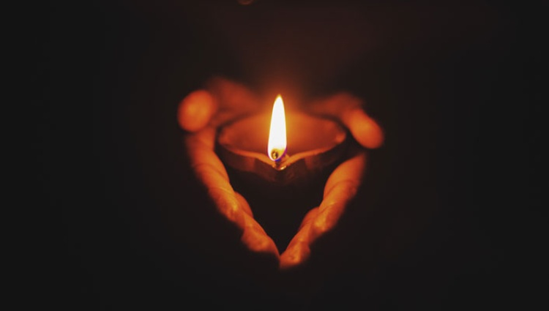
2. Be Thankful for the Dark Times
How do you do this when it’s Dark in your life? Hold on - we must stay in the LORD………
1st Thessalonians 5:18
Psalms 23:4
Job 13:15
Romans 5: 3-6
Romans 8:18
1st Peter 1: 6-7
Dark Times force us to rely on GOD’s Grace alone
Sometimes we have been put in a situation where its GOD or nothing………
2nd Corinthians 1: 8-9
Hebrews 13:6
1st Corinthians 15:10

