Slide 1
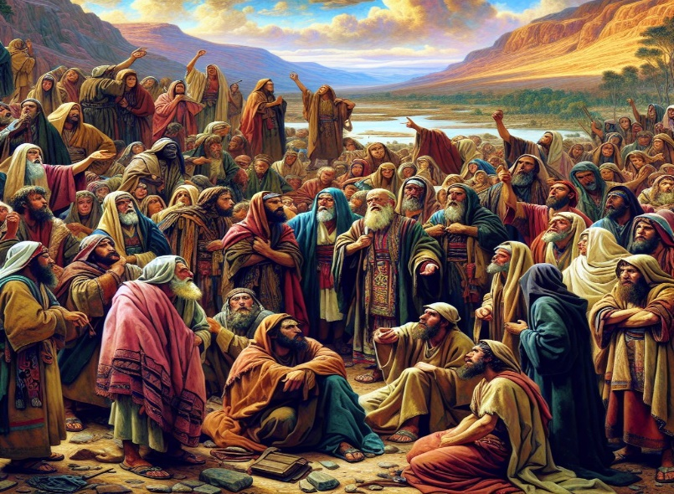
Development is necessary!!
A Look at the Children of Israel
Numbers 11: 1-2
Numbers 11: 4-9
Numbers 13: 28-30
Numbers 13: 31-33
Numbers 14: 26-37

Slide 2
Facts
GOD blessed the children of Israel with a leader, Moses, who led them from slavery in Egypt. They saw many miracles on their journey.
As if the parting of the Red Sea on dry land and the defeat of Pharoah’s army was not enough!
Look at some of the Miracles
Pillar of cloud and fire -- Exodus 13: 20 -22
Bitter water made sweet at Marah – Exodus 15: 22-27
Quails - Numbers 11:31-33
Manna – Exodus 16: 11-15 , Numbers 11:1-9
Water from the Rock – Exodus 17: 5-6
Defeating the Amelakites - Exodus 17: 8 – 14
In our own lives, GOD has brought us through so many things; we have forgotten most of them. They may not have been on this scale, but they were huge blessings to us. Family, there comes a time when GOD wants to take us to different levels. With that comes a stage that we do not like. Often it puts fear and apprehension in us.

Slide 3
GOD has plans for all of us and we definitely want to live out the plan GOD has for our lives and not our own – Amen. But, and there is always a but, we have to go through a “Deliverance” stage in our growth to get where GOD wants us. That started once we accepted JESUS CHRIST as our personal LORD and SAVIOR.
Romans 10:9-10
Salvation – Greek – soteria or soterion – deliverance , rescue - from based word soter – deliverer – JESUS CHRIST
As Christians, we can sometimes get discouraged after being delivered because there is another stage we must go through to get where GOD wants us and that is “DEVELOPMENT”. GOD needs us, Family, and in order to use us, we have to be developed. This is that stage that really challenges us in many ways – Amennnn!! Development is where great transformation takes place. This can be points in our lives, rather small or big, where GOD wants to get us to another level. It may be uncomfortable, mind blowing and totally different.

Slide 4

We see something ahead that scares us. We start listening to other people or we are too busy looking in the review mirror Family!!!!!
Development is a way of GOD preparing us for new levels. It is necessary, but not a desired step. He knows what you need when you get there…..
Moses , Paul, Jonah and many many many others went through Development.
Be encouraged - GOD has you – Amen ….
Deuteronomy 31: 6, 8
1st Peter 5:7
2nd Timothy 1:7
Hebrews 4: 16

Slide 5


The realities of circumstances in life, chatter, what we physically see or our past can muffle what the HOLY SPIRIT is saying to us. Life is hard and can get us down. When GOD wants to move us from one stage of growth to another level of growth in whatever area he wants to move us in, Deliverance to Development has to take place. Why?
Development is what prepares you for that next phase, and without it we will not get there. That’s why it is so difficult and challenging. (Sports example - Heat Treat)
Family, we will not find the word Development in scripture; but it’s all in scripture. GOD developing people is threaded all through scripture. For us it comes down to the moment when that time comes. What is our spiritual mind set? That is the key to entering into the development phase.
Romans 8: 5-8
Hebrew 11:6

Slide 6
We would not know how Great and Powerful GOD is without it. 2nd Corinthians 12:9
But as we are going through it, we must stay in the Lord – Proverbs 16:3, James 1:5-6 Proverbs 19:21
It may bring forth:
Hard times
Discouragement
Hurts
Temper pushing
Going without
Yell Prevention
Crying
Pushing ( 1 Kings 18: 41-42)
Not wanting to forgive
Not tithing
Not being able to praise during the tough times
Statements like, “I have never done that before” or “I don’t have the talent”.

Slide 7

These challenges that we face can put us in a defeated mindset. When we steer from the Development Phase GOD can leave us to ourselves. Numbers 14: 26 - 37
What can we learn from the children of Israel that can help us today so we don’t end up “wandering?”
Let’s look at 4 things that can help us endure Development
1) We have to stop the unwarranted complaining…. Numbers 11:1-2
- It angers GOD
1 Corinthians 10: 6-13 – They are an example for us not to complain
Numbers 11:10 – 15 Unwarranted complaining can mess up a leaders spirit – Moses wanted to die

Slide 8

Genesis 3:12 – It can shift responsibility
Philippians 2:14-15
Will you give God an opportunity to work on your behalf by trusting Him or miss
out on His provision by complaining.
2) Don’t look back in a way that prevents a move forward
Numbers 11 : 4- 9
Looking back can blind your blessings. Have you ever tried to drive backwards to
go somewhere looking in the rear view mirror. It does not work….

Slide 9
3) Trust that GOD will guide you through it, no matter what you see – Numbers 13: 28-30
Exodus 13:17 – He led them around what may have frightened them
Ecclesiastes 11:5 – If GOD can put life in a womb, He can do it
Proverbs 18:10 – GOD is a strong tower
Psalms 34: 4-5 – He is a deliverer from your fears
Psalms 56: 3-4 – When we get shaky, put our trust in Him
Psalms 46: 1-3 – He is there when we need Him
4) Watch the chatter , you cannot listen to the naysayers when GOD has already shown
out. Numbers 13: 31-33
They listened to the 10 spies, the majority. Joshua and Caleb’s voices of courage and
faith to move forward were squashed. The spies told them what they saw and it was
what GOD promised, but they focused on the challenges and not on GOD.
Note : We do not see GOD mentioned in the midst of the challenges of what they saw.
Challenges and fear can blot out what we know GOD can do in our lives

Slide 10
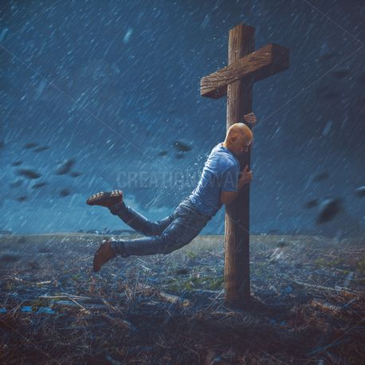
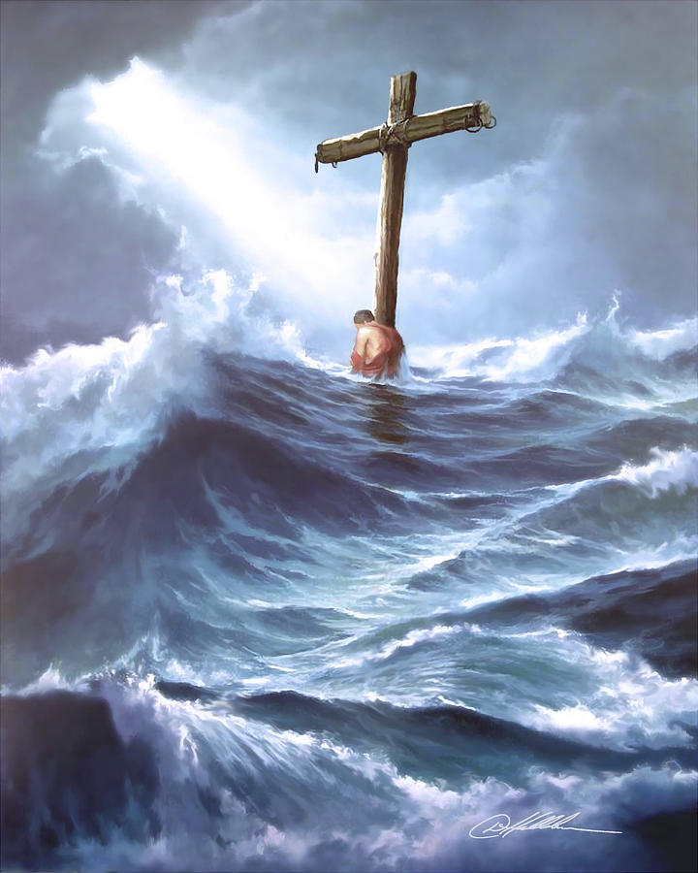
4) Cont….
Put your trust in GOD, not man. GOD is with you, GOD makes it possible
Psalms 118:8
Joshua 1:9
Proverbs 29:25
Psalms 56:4
Luke 18:27

