Slide 1
Let’s Get Suited Up!
Put On the Whole Armor of God!
Ephesians 6:10-18
Minister John E. Cavanaugh
August 13, 2024

Slide 2
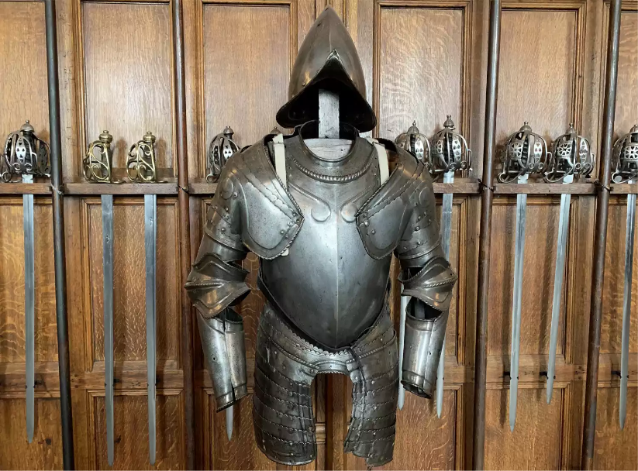

Slide 3
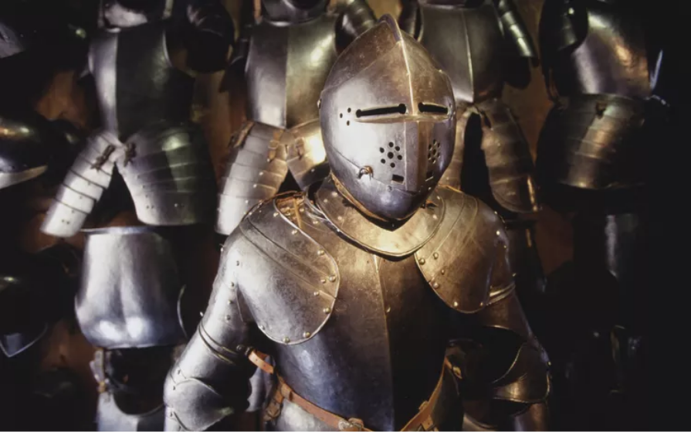
Armor of God

Slide 4
In this illustrated step-by-step study of the Armor of God, you'll learn the importance of wearing your spiritual armor daily and how it protects against Satan's attacks.
None of these six pieces of armor require power on our part. Jesus Christ has already won our victory through His sacrificial death on the cross. We only have to put on the effective armor He has given us.

Slide 5
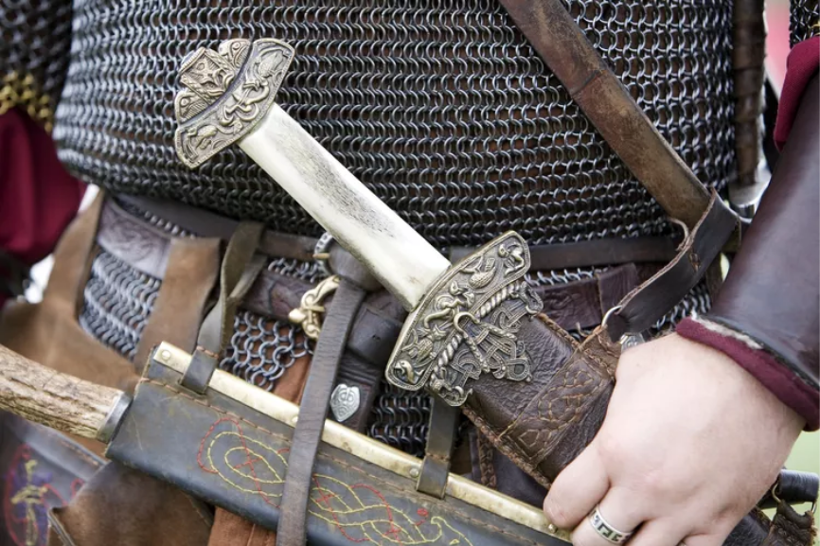
Belt of Truth

Slide 6
The Belt of Truth is the first element of the Armor of God. In the ancient world, a soldier's belt not only kept his armor in place but, if wide enough, protected his kidneys and other vital organs. Just so, the truth protects us. Practically applied, you might say the Belt of Truth holds up our spiritual pants so that we're not exposed and vulnerable.

Slide 7
Jesus Christ called Satan the father of lies: "He [the devil] was a murderer from the beginning. He has always hated the truth, because there is no truth in him. When he lies, it is consistent with his character; for he is a liar and the father of lies" (John 8:44, NLT).

Slide 8
Deception is one of the enemy's oldest tactics. We can see through Satan's lies by holding them against the truth of the Bible. The Bible helps us defeat the lies of materialism, Money, (Mark 10:25, Exodus 20:3) power, and pleasure, as the most important things in life. Thus, the truth of God's Word shines its light of integrity (Job 2:3, 1 Chronicles 29:17) into our lives and holds together all of our spiritual defenses.
Jesus told us, “…I am the way and the truth and the life, no man cometh unto the Father, but by me" (John 14:6).

Slide 9
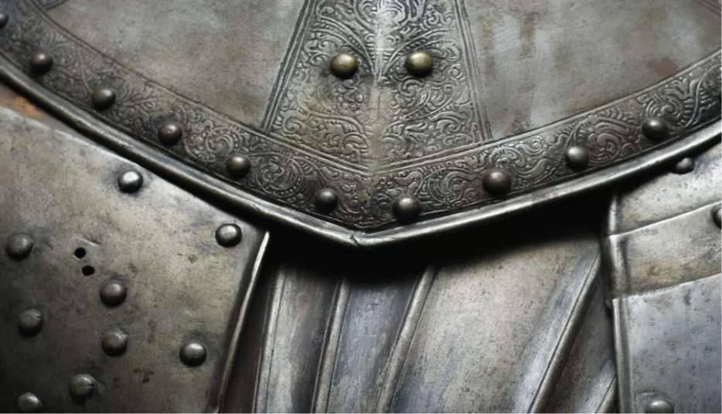
Breastplate of Righteousness

Slide 10
The Breastplate of Righteousness guards our hearts. A wound to the chest can be fatal. That's why ancient soldiers wore a breastplate covering their hearts and lungs.
Our heart is susceptible to the wickedness of this world, but our protection is the righteousness that comes from Jesus Christ. We cannot become righteous through our own good works. When Jesus died on the cross, His righteousness was credited to all who believed in Him, through justification.

Slide 11
God sees us as sinless because of what His Son did for us: "For He hath made Him to be sin for us, who knew no sin; that we might be made the righteousness of God in Him." (2 Corinthians 5:21).
Accept your Christ-given righteousness; let it cover and protect you. Remember that it can keep your heart strong and pure for God: “Keep thy heart with all diligence; for out of it are the issues of life" (Proverbs 4:23).

Slide 12
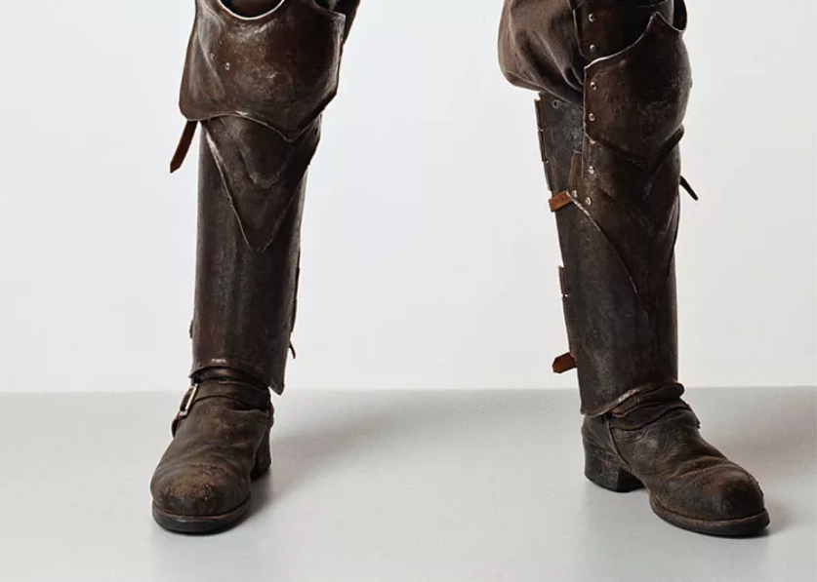
Gospel of Peace

Slide 13
Ephesians 6:15, talks about fitting our feet with the readiness that comes from the Gospel of Peace. The terrain was rocky in the ancient world, requiring sturdy, protective footwear. On a battlefield or near a fort, the enemy might scatter barbed spikes or sharp stones to slow an army down. In the same way, Satan scatters traps for us as we're trying to spread the gospel.

Slide 14
The Gospel of Peace is our protection, reminding us that it is by grace that souls are saved. We can side-step Satan's obstacles when we remember, "For God so loved the world that He gave his one and only Son, that whosoever believeth in Him should not perish but have everlasting life" (John 3:16).

Slide 15
Fitting our feet with the readiness of the Gospel of Peace is described in 1 Peter 3:15, like this: "But sanctify the Lord God in your hearts: and be ready always to give an answer to every man that asketh you a reason of the hope that is in you with meekness and fear.”
Sharing the gospel of salvation ultimately brings peace between God and men. (Romans 5:1).

Slide 16
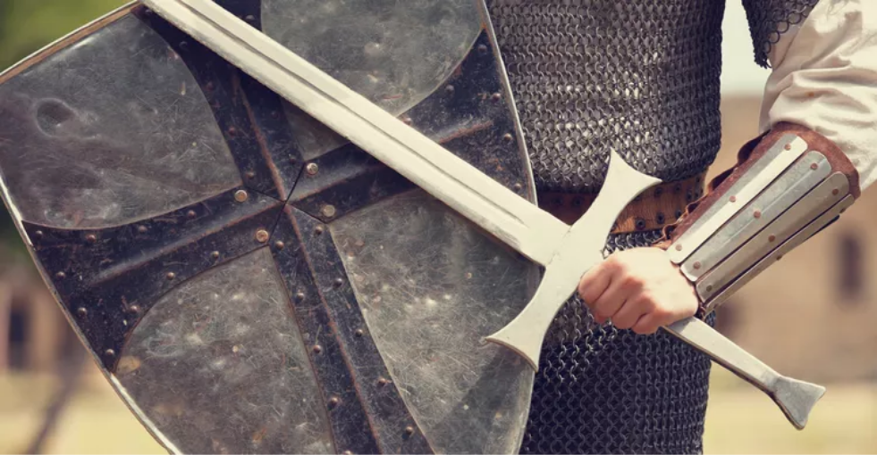
Shield of Faith

Slide 17
No defensive armor was as important as the shield. It fended off arrows, spears, and swords. Our Shield of Faith guards us against one of Satan's deadliest weapons: doubt.
Satan shoots doubt at us when God does not act immediately or visibly. But our faith (Ephesians 2:8–9), in God's trustworthiness comes from the unassailable truth of the Bible. We know our Father can be counted on.

Slide 18
Faith and doubt don't mix. Our shield of faith sends Satan's flaming arrows of doubt glancing harmlessly to the side. We keep our shield held high, confident in the knowledge that God provides for us, God protects us, and God is faithful to us, His children. Our shield holds because of the One our faith is in, Jesus Christ.

Slide 19
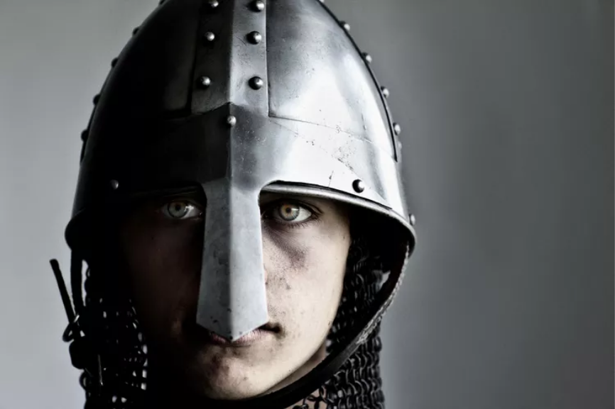
Helmet of Salvation

Slide 20
The Helmet of Salvation protects the head, where all thought and knowledge reside. Jesus Christ said, “…If ye continue in My word,m then are ye My disciples indeed; And ye shall know the truth, and the truth shall make you free.” (John 8:31-32).
The truth of salvation through Christ does indeed set us free. We are free from vain searching, free from the meaningless temptations of this world, and free from the condemnation of sin. Those who reject God's plan of salvation battle Satan unprotected and suffer the fatal blow of hell.

Slide 21
1 Corinthians 2:16, tells us that believers "have the mind of Christ." Even more interesting, 2 Corinthians 10:5, explains that those who are in Christ have the divine power to "demolish arguments and every pretension that sets itself up against the knowledge of God, and we take captive every thought to make it obedient to Christ" (NIV). The Helmet of Salvation to protect our thoughts and minds is a crucial piece of armor. We cannot survive without it.

Slide 22
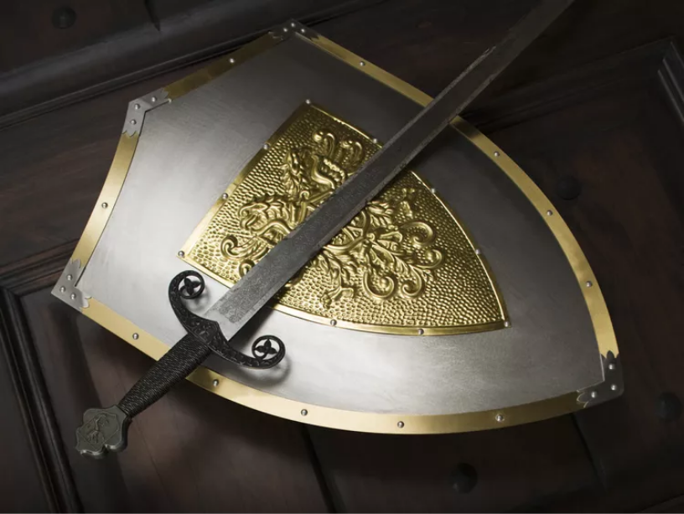
Sword of the Spirit

Slide 23
The Sword of the Spirit is the only offensive weapon in the armor of God with which we can strike against Satan. This weapon represents the Word of God, the Bible: "For the word of God is quick and powerful, and sharper than any twoedged sword, piercing even to the dividing asunder of soul and spirit, and of the joints and marrow, and is a discerner of the thoughts and intents of the heart" (Hebrews 4:12).

Slide 24
When Jesus Christ was tempted in the desert by Satan, He countered with the truth of scripture, setting an example for us to follow: “…It is written, Man shall not live by bread alone, but by every word that proceedeth out of the mouth of God." (Matthew 4:4).
Satan's tactics have not changed, so the Sword of the Spirit is still our best defense.

Slide 25
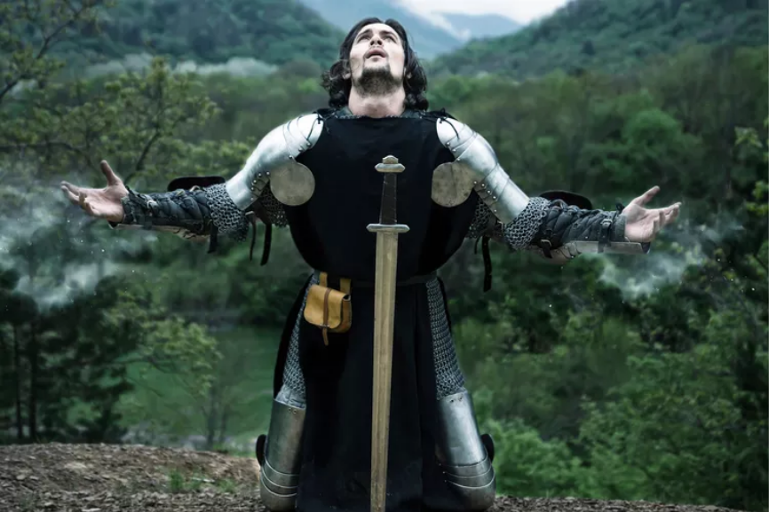
The Power of Prayer

Slide 26
Finally, Paul adds the power of prayer to the Armor of God: “Praying always with all prayer and supplication in the Spirit, and watching thereunto with all perseverance and supplication for all saints;" (Ephesians 6:18).
Every smart soldier knows they must keep the lines of communication open to their Commander. God has orders for us, through his Word and the promptings of the Holy Spirit. Satan hates it when we pray. He knows prayer strengthens us and keeps us alert to his deception. Paul cautions us to pray for others as well. With the Armor of God and the gift of prayer, we can be ready for whatever the enemy throws at us.

Slide 27
Scriptures That Will Help Keep Us Equipped For Our Journey

Slide 28
1). Hebrews 13:21 (ESV) Equip you with everything good that you may do his will, working in us that which is pleasing in his sight, through Jesus Christ, to whom be glory forever and ever. Amen.
2). 2 Timothy 3:16-17 (ESV) All Scripture is breathed out by God and profitable for teaching, for reproof, for correction, and for training in righteousness, that the man of God may be complete, equipped for every good work.

Slide 29
3). 2 Peter 1:3 (ESV) His divine power has granted to us all things that pertain to life and godliness, through the knowledge of him who called us to his own glory and excellence,
4). Ephesians 2:10 (ESV) For we are his workmanship, created in Christ Jesus for good works, which God prepared beforehand, that we should walk in them.

Slide 30
5). 2 Corinthians 10:3-5 (ESV) For though we walk in the flesh, we are not waging war according to the flesh. For the weapons of our warfare are not of the flesh but have divine power to destroy strongholds. We destroy arguments and every lofty opinion raised against the knowledge of God, and take every thought captive to obey Christ,
6). 1 Timothy 6:12 (ESV) Fight the good fight of the faith. Take hold of the eternal life to which you were called, and about which you made the good confession in the presence of many witnesses.

Slide 31
7. Hebrews 13:20-21 (ESV) Now may the God of peace who brought again from the dead our Lord Jesus, the great shepherd of the sheep, by the blood of the eternal covenant, equip you with everything good that you may do his will, working in us that which is pleasing in his sight, through Jesus Christ, to whom be glory forever and ever. Amen.

