Slide 1
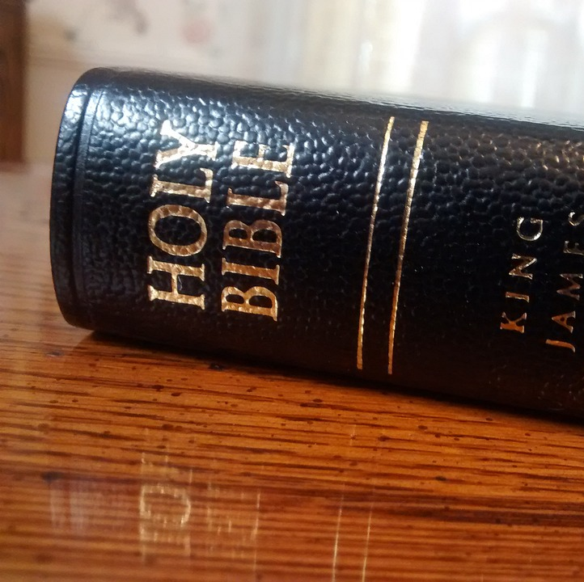
Law and Grace
Min.Cameron Foster
Mt. Zion Missionary Baptist Church
Bible Study
August 14, 2024

Slide 2
Scripture Text
Exodus 20 - The Ten Commandments
Exodus 20:3 – "Thou shalt have no other gods be me"
God wants what is best for you. If you put something else before Him in your life, it is harder for Him to bless you.
Exodus 20:4 – "Thou shalt not make unto thee any graven image"
Anything you worship more than God is a graven image; cars, clothes, sports, even our jobs are dangerous things to worship because they can go away. But God will never go away and that's why it's best for us to only worship Him.

Slide 3
Scripture Text
Exodus 20:7 – "Thou shalt not take the name of the Lord thy God in vain."
This can mean using God’s name like a swear word or it can mean saying you are a Christian but not living or acting like Jesus would want you to act.
Exodus 20:8 – "Remember the Sabbath day, to keep it holy." The Sabbath day is a day we can all go to church, worship God and learn how to be better people and Christians. Keeping it Holy means doing our best to remember him throughout the day.

Slide 4
Scripture Text
Exodus 20:12 – "Honor thy father and mother." It is important to show our parents respect.
Exodus 20:13 – "Thou shalt not kill." A simple but important rule.
Exodus 20:14 – "Thou shalt not commit adultery."
Exodus 20:15 – "Thou shalt not steal."
Exodus 20:16 – "Thou shalt not bear false witness against thy neighbor."
Exodus 20:17 – "Thou shalt not covet thy neighbor's house. Thou shalt not covet thy neighbor's wife, nor his manservant, nor his maidservant, nor his ox, his ass, nor any thing that is thy neighbor's.”

Slide 5
What the Law Does
Deuteronomy 29:29 – The secret things belong unto the Lord our God: but those things which are revealed belong unto us and to our children for ever, that we may do all the words of this law
Deuteronomy 30:11-20
The Law of Moses was a covenant of works. God said "You shall" and "You shall not." The laws were definite, and the attached penalties were definite if the conditions were not obeyed.
These laws were presented as God's standard of righteousness for that time.

Slide 6
What the Law Does
It was literally a yard stick for man.
The New Testament reveals that "by the law is the knowledge of sin" Jesus Christ came to fulfill the law and now God's standard of righteousness is Christ Himself.
How does fulfilling Christ‘s commandments result in keeping the law? When we love God first and others second, we will naturally fulfill the other laws.
James emphasizes the importance of the law.
James 2:12 – So speak ye, and so do, as they that shall be judged by the law of liberty.
James 2:13 – For he shall have judgement without mercy, that hath shown no mercy: and rejoiceth against judgement.

Slide 7
What the Law Does
When we deal with others and their shortcomings, we should treat them with mercy so we will not fall under the judgement of the law. When we expect others to fulfill the law, God will then expect us to live up to the law's standards too.
The world uses a yardstick for almost every part of life. We have speedometers on our cars. We work a certain number of hours per day on our jobs. We measure ingredients in recipes. We are charged by how many gallons we use and how long the job takes and we are graded in school. Yet the world expects God to look the other way when evaluating our morals. But God has His own yardstick and no one can live up to His standards.

Slide 8
What the Law Does
God's people respond to the things He has revealed of Himself – Deuteronomy 29:29; 30:11-19 (Follow all the words of the law.)
The summary of all the law-Deuteronomy 30:16, 20( Love the Lord your God: walk in His ways; keep His commandments; obey His voice.
The will of God in Mark 12:29 –31(And Jesus answered him, The first of all the commandments is Hear O Israel; The Lord our God is one Lord:
30: And thou shalt love the Lord thy God with all thy heart, and with all thy soul and with all thy mind, and with all thy strength: this is the first commandment.
31: And the second is like, namely this Thou shalt love thy neighbor as thyself. There is none other commandment greater than these.

Slide 9
What Grace Does
God has shown us a different way to heaven; not by being good enough and trying to keep His laws. The scriptures told about it long ago. God says He will accept and acquit us (declare us (not guilty). If we trust Jesus Christ to take away our sins, we all can be saved in this way by coming to Christ, no matter who we are or what we have been like.

Slide 10
What Grace Does
For all have sinned, and come short of the glory of God (Romans 3:23). Yet now God declares us not guilty of offending Him if we trust in Jesus Christ, who, in His kindness, freely take away our sins.
God sent Jesus Christ to take the punishment for our sins and to end all God's anger against us. He used His blood and our faith as the means of saving us from His wrath.

Slide 11
What Grace Does
Grace is the kindness and love of God expressed toward us entirely apart from what we deserve ( Titus 3:5,6,7)
5: Not by works of righteousness which we have done, but according to His mercy He has saved us by the washing of regeneration, and renewing of the Holy Ghost;
6: Which He shed on us abundantly through Jesus Christ our Savior;
7: That being justified by His grace, we should be made heirs according to the hope of eternal life.

Slide 12
What Grace Does
Romans 4:4 – Now to him that worketh is the reward not reckoned of grace, but of debt,
5: But to him that worketh not, but believeth on Him that justifieth the ungodly, his faith is counted for righteousness.
Under the law, we earn whatever we get. Under grace, whatever we get is a free gift.

Slide 13
What Grace Does
Since grace depends only on our accepting it, not on what we deserve, it is in no way dependent on how good we are and can never be limited to how bad we are. God did the most for us when we deserved Him the least.
Romans 5:8- But God commandeth His love toward us that while we were yet sinners, Christ die for us.

Slide 14
What Grace Does
God cannot love more than He already does. Knowing this we can open ourselves to God’s love and He will begin building our self-esteem that has been damaged by sin and from living in a harsh world.
When we realize that we are perfect in God's eyes, we can respond fully to His love by loving Him, by being filled with His Holy Spirit, then loving our neighbors and friends.
As we love God and others, we will naturally keep the commandments. We could not do it in our own strength.

Slide 15
What Grace Does
The difference between law and grace is that grace is unmerited favor and law is living up to a perfect standard.
The Law (He fulfilled it Perfectly)
Grace (By paying for our sins, He allowed God to exercise grace on our behalf.)
The Law (It revealed my sin)
Grace (It opens the way for me to have a relationship with God)

