Slide 1
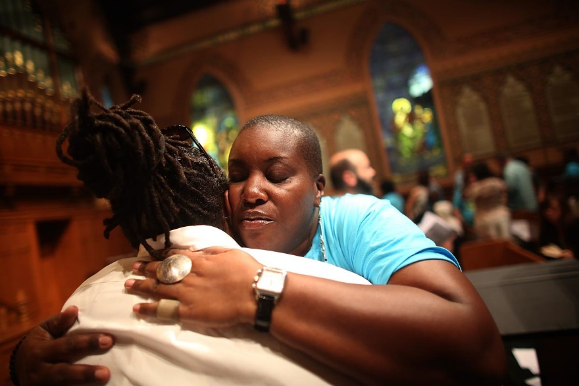

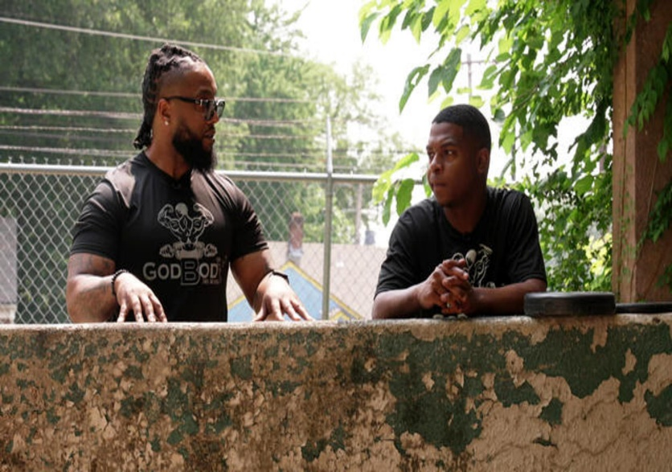
Be Encouraged Family “Well doing” Is Worth It..
Galatians 6:7-9

Slide 2
Context
Paul wrote the book of Galatians mainly because the Judiazers had infiltrated Galatia and were making claims that in order to be saved, you had to follow the Mosaic law. They were bringing up salvation by works; mainly bringing up circumcision.
Galatians 1 : 6-10
Lets check out Act 15 where this all started. After Paul had been stoned and left for dead at the end of Acts 14, Paul and Barnabas had gone to several cites spreading the Gospel, establishing churches and ordaining elders. Act 14: 19 –28
Acts 15: 1 , 5 - They were teaching folks bad doctrine; salvation by works, which we know, of course, is false. Romans 10:9-10 and Ephesians 2: 8-9
Peter spoke up in Acts 15: 7-10
So this same argument came up in Galatia. The Judiazers brought up works again. That was their intent to go wherever sound doctrine was preached and start some stuff.
Galatians 2:1-9 ( NIV) Paul gets them straight on circumcision
Galatians 2:11-13 – Peter and Barnabas started to backslide
Galatians 3: 1 – 5 – Paul Chastised the Galatians for backsliding
Studies show us that Paul was dealing with issues in other cities, such as Corinth, also around the same time

Slide 3
So Paul has a lot going on
Juadizars are trying to teach keeping the law for salvation
He has to get them straight on circumcision
Peter and Barnabas flipped and he had to confront them
Plus dealing with other cities during the same general time period
Galatians 5: 1-4 – He encourages them
V16-21 tells them what the works of the flesh are.
V22 he comes back with the bright side, the fruit of the spirit
Paul had a lot going at this particular time. In 2nd Corinthians 11:24-33 he tells of some of the other challenges he faced.
Biblical scholars tells us Paul must have travelled some 9,150 miles during his missionary journeys by foot. We also know he travelled by boat. He was shipwrecked in Acts 27. WOW! What a heart to not give up!!
But scripture records the Holy Spirit moving in him to be encouraged and to encourage also in his journeys.
Phillipians 1:6
Phillipians 3:14 -15
Phillipians 4:13

Slide 4
Galatians 6:9 – And let us not be weary in well doing, for in due season we shall reap if we faint not.
Us – Notice Paul is saying us and not you. He is including himself in this statement. He has been through a lot as we saw in the previous pages. Also this us specifies something. This is not for everybody; it’s for Christian folk. He did not say everybody including the unsaved. He said us. So let us not look to society and the world when we are striving to not be weary family. We cannot, absolutely not, look at what other folk in the world are doing. Amen! A lot of folks are quitting on striving to live GODLY.
Guard yourself on social media , news , so-called friends etc.
Weary - Greek word (compound word) ekkakeo --- ek and kakeo
This is the type of fatigue that causes us to want to fail/stop at what we are attempting to do.
The Holy Spirit thru the scripture is telling us “don’t” be weary - Don’t Quit Family
Yes its hard , Yes its hard but don’t Quit
Hang in there –Isaiah 41:10 , Psalms 130:5

Slide 5
Weary – con’t
1 Corinthians 15:51-58
V58 - steadfast – Greek word – edephos – to sit , sedentary – seated on it
umoveable Greek word – ametakinetos – You are not moving
always abounding in the work of the Lord…
Have you ever grown weary of doing right in the sight of GOD vs. well doing? Of course, the answer is a resounding Yes. Rather small or huge, we have all been there on many many many occasions. These times in our lives, however long they last, can be very challenging for us. Let’s be real, it can be hard to do “ Well Doing”- Amen. It’s hard to keep doing with no reward – WOW!
Isn’t it strange that sometimes we can be fine with doing wrong and it not phase us? Ouch. You know how we can be. Sometimes we can slip into a wrong doing phase and stay there. Why? Because it can give us some immediate fleshly gratification. Unlike when we are well doing, we don’t often see that immediate gratification. Amen!

Slide 6


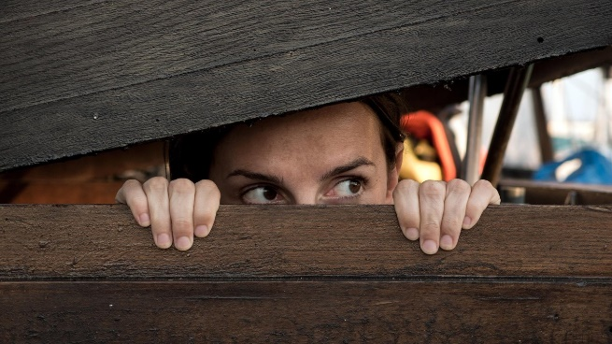
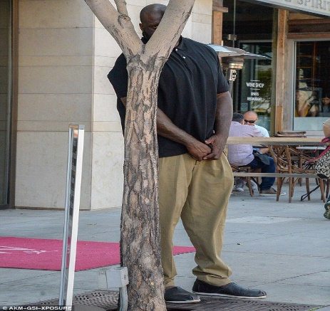
Here are a few things that we can fall trapped into!
Gossip
Cutting people down
Withholding Loving someone
Rude
Horrible attitude
Setting Traps
Lying
Just being evil, etc. etc. The list is infinite, right?
When we stay here, we often feel like we have accomplished something.
This is a very dangerous phase that we can slip into and subconsciously be satisfied. If we are not careful our flesh can feed off this evil spirit and this kind of behavior can grow and become a monster.

Slide 7
Here are just a very very few well doing situations that can be hard, right? Real talk. There usually is not immediate gratification in these when you are in them for a season!!!!!!
Be Kind when you are being dumped on..
Wow, coming to church, Bible study, prayer meeting - growing -learning and things seem to get worse..
Hold your tongue to not give out fire..
Being Patient in a tough spot..
Smiling when someone needs it and you don’t want to give it..
Going to the meetings anyway when you know they are coming after you..
Telling your children NO – when other parents are saying Yes..
Denying your children a vice that all other kids are doing..
Your crew calls you and you know they will participate in a vice that you are trying to give up..
Marriage on the rocks..
Being respectful ..
Speaking Peace when you want to drop a bomb in a situation..
The rains seems to never stop in your life and your are struggling to stay prayed up and faithful..
Somebody is giving you the finger when you cut them off and you are trying to keep your cool..
When everyone else seems to be doing it , should I or we?
Wow I am always the one that is being nice and forgiving..
Let somebody else do it..
Not being appreciated, etc., etc.

Slide 8
Let’s be calibrated and make sure our well doing” is GODLY. This can happen to us and we have the best intentions. We think we are doing the right thing, but we are placating or doing wrong – Oh boy!!
Galatians 6: 7 – 8
Proverbs 14:12
Genesis 3: 1-7
Isaiah 5:20 – 21
Proverbs 3:7
What are some practical examples:
Your friend is doing some bad stuff, but you don’t say anything, You want to keep the friendship going well– Silence in some cases means your are culpable..
You are going along with the crowd, organizations, groups, family meeting when we know it’s ungodly. We don’t want things to be disturbed. We think we are well doing.
We are fearful of telling our spouse or children they are dead wrong and we let it go to keep things smooth..

Slide 9
What are some practical examples (con’t)
We contribute money to ungodly causes..
We are doing service for self gain and not from the heart. Don’t really care about who you are serving….
We are doing for a friend and we are enabling instead of helping..
We have to be careful with these things. So how do we know we are well doing?
Are you carrying out what the word says or what people or the world says? Let’s go back to Galatians 5:16 thru 26. We see the good and the bad here. Which scripture are we in 5:16-21 or 5:22-26?
The toughest thing in well doing sometimes is patience -- for in due season. Sometimes our well doing does not have and expiration date –Lord Lord!!!!!. We begin to ask when is this thing going to turn around. Lets go back to our well doing list. When are some of these things going to stop, end, or turn around in my favor.
The scripture says in due season. GOD’s timing is not ours. Amen! – Ecclesiastes 3:1, Isaiah 55:8
We Shall Reap
Reap – Greek – therizo – to harvest. Have you ever waited on GOD and you landed in Ephesians 3:20?
To harvest means to bring in a lot of stuff; not just one thing, Amen. There is nothing like it when GOD allows us to harvest. WOW! Check out some examples on the next page.

Slide 10
Let’s talk
Season of spiritual struggle, financial issues , health issues, unemployment, marriage in trouble, boss issues, children in trouble, depression, addiction has you in a headlock, friendship on the rocks etc.
In due season and in His timing, GOD can have us in a reaping state in these above examples.
But there is the final ending to the verse – if we faint not.
Don’t give up! Don’t give up!
Endure/Withstand!
Wait on GOD!

