Slide 1
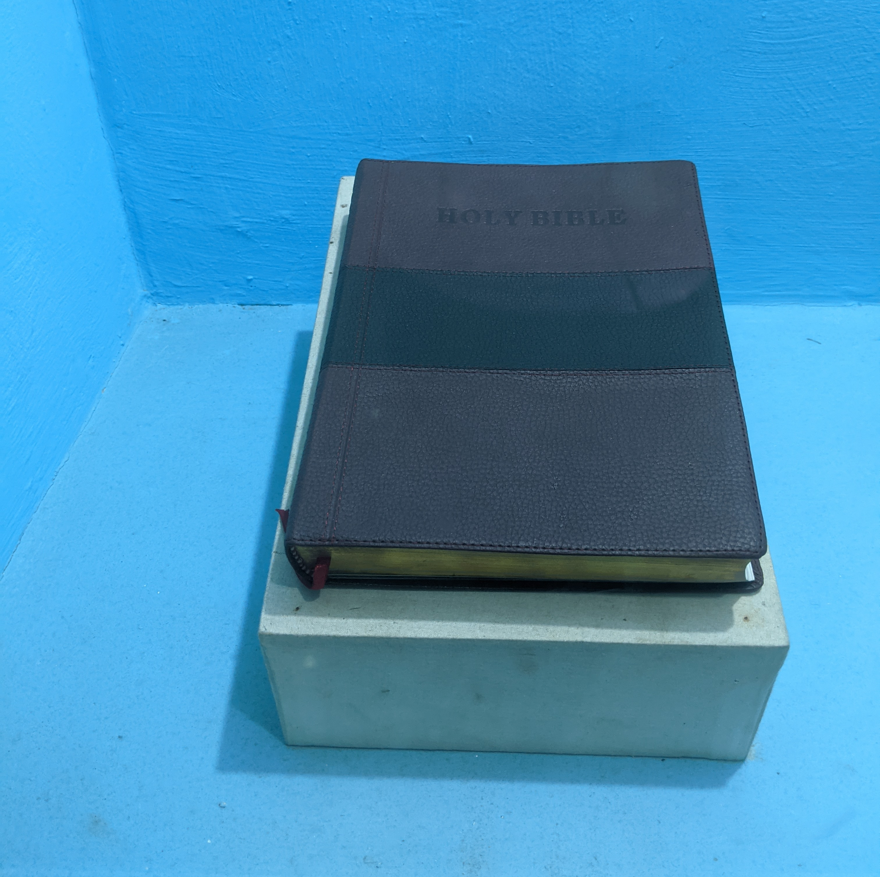
WHY WE WITNESS
Min. Cameron Foster
Mt. Zion Missionary Baptist Church
Bible Study
August 28, 2024

Slide 2
Scripture Text
Romans 10:14 – How then shall they call on Him in whom they have not believed? and how shall they believe in Him of whom they have not heard? and how shall they hear without a preacher?
A witness is one who first receives the gospel himself, then proclaims that truth to others. One can never teach or testify to a truth that he does not first personally believe and practice.

Slide 3
What is a Witness?
What a witness does is tell what he/she has experienced.
It is like sharing your faith in Christ and what He has done for us.
Tell others how He has saved you.

Slide 4

Why is this hard for you to do?

Slide 5
Motivation for Witnessing
Jesus commanded us to...
Go ye therefore, and teach all nations, baptizing them in the name of the Father, and the Son, and of the Holy Ghost:
Teaching them to observe all things whatsoever I have commanded you: and, lo I am with you alway, even to the end of the world. Amen Matthew 28:19-20

Slide 6
Motivation for Witnessing
What attitude should we have about Jesus and what Jesus has done for us? We should no longer live for ourselves, but for him.
How should that change our lives? We should do what He asks us to do; not live for our selfish desires.
What does Jesus Christ say about the one who is ashamed of Him? For whosoever shall be ashamed of Me and My words, of him shall the Son of man be ashamed, when He shall come in His own glory, and in His Father's and of the holy angels. (Mark 9:26)

Slide 7
Motivation for Witnessing
The Message
We are called Christ's Ambassadors (2nd Corinthians 5:20 – Now then we are ambassadors for Christ, as though God did beseech you by us: we pray you in Christ's stead, be ye reconciled to God).
God relays His message through us. We are not citizens of this world, but of God's kingdom. Our lifestyle reflects on God's reputation. Our authority comes from God, not from any man. Non-Christians will know what God is like through our example.

Slide 8
Motivation for Witnessing
The Message
Jesus came into the world. ( Luke 19:10 – For the son of man is come to seek and to save that which was lost.)
Mark 10:45 - For even the son of man came not to be ministered unto, but to minister, and to give His life for a ransom for many.

Slide 9
Motivation for Witnessing
Reasons for Witnessing
To Glorify God. (John 15:8 - Herein is my Father glorified, that ye bear much fruit; so shall ye be My disciples.
So, our prayers will be answered. (John 15:16 - Ye have not chosen Me, but I have chosen you, and ordained you, that ye should go and bring forth fruit, and that your fruit should remain, that whatsoever ye shall ask of the Father in My name, He may give it you.

Slide 10
Motivation for Witnessing
Conclusion
Because Christ rose from the dead I.......
Why do you believe it is important that you, personally be a witness for Christ?

