Slide 1
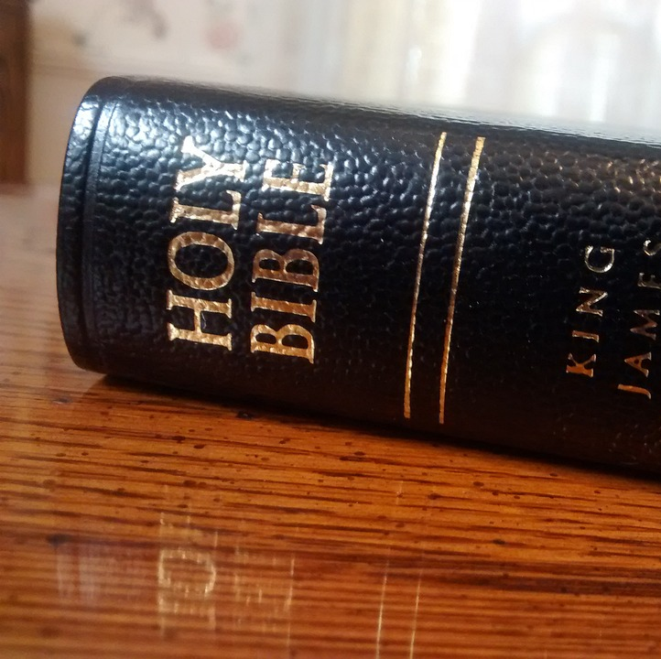
Qualifications for Witnessing
Mt. Zion Missionary Baptist Church
Bible Study
October 2, 2024
Min.Cameron Foster

Slide 2
Scripture Text
Acts 8: 26 –40
26- And the angel of the Lord spake unto Philip saying, Arise, and go toward the south unto the way that goeth down from Jerusalem unto Gaza, which is desert.
27- And he arose and went: and, behold, a man of Ethiopia, an eunuch of great authority under Candace queen of the Ethiopians, who had charge of all her treasure, and had come to Jerusalem for worship,

Slide 3
Philip's Opportunity
According to verses 26 and 27, why do you think God called Philip for this particular assignment? (HE WAS OBEDIENT)
To whom did Philip witness? (An Ethiopian eunuch who was court official and treasurer for the Queen.)

Slide 4
Scripture Text
Acts 8:28 - 31
28- Was returning, and sitting in his chariot read Esaias the prophet.
29- Then the Spirit said unto Philip, Go near, join thyself to this chariot.
30- And Philip ran thither to him and heard him read the prophet Esaias, and said, Understand thou what thou readest?
31- And he said, How can I, except some man should guide me? And he desired Philip that he would come and sit with him.

Slide 5
Philip's Opportunity
Verse 30- Philip responded when he ran up to the chariot
Verse 30- Philip asked the Ethiopian did he understand what he was reading.
Verse 32- The place of the scripture which he read was this, He was led as a sheep to the slaughter; and like a lamb dumb before his shearer, so opened he not his mouth. Reference Isaiah 53:7

Slide 6
Philip's Opportunity
The Word of God is the only effective means of opening up the minds and hearts of people to the gospel.
The Holy Spirit had prepared the Ethiopian's heart. God used a man to win him. Philip had earned the right to be used.

Slide 7
Philip's Qualifications
Philip demonstrated at least eight qualities that contributed to his effectiveness for Christ.
Knowledge of the Word of God –verse 35
Boldness- verse 30
Compassion – verse 30
Humility –verse 27
Obedience- verses 27, 30

Slide 8
Philip's Qualification
Receptivity, sensitivity to guidance verses-27, 30, 35, 38
Tact verse –30
Enthusiasm verses 27, 30,40

Slide 9
Philip's Qualification
God does not want us to wait until we feel we have mastered each of the qualities before we witness. God wants us to be faithful to witness and to be building these qualities into our lives as we go. Sometimes the experiences we encounter as we introduce others to Christ will help us build good qualities.

Slide 10
Possible Hinderances to Our Witnessing
Spiritual Lethargy
Not be excited about something; chances are you won't tell many people about it. The Christian walk has been dulled by everyday distractions, materialistic pursuits and unconfessed sin.
We can avoid spiritual lethargy by walking close to God and asking him to reveal the attitudes of our hearts.
Psalms 139:23-24
Lack of preparation - personal dedication to Christ and understanding how to witness and what to say are imperative.
Preparing your heart through prayer gives you the right attitude and opens yourself to the power of the Holy Spirit.

Slide 11
Possible Hinderances to Our Witnessing
Fear of man
We can witness for God's glory. Focusing on Him keeps our eyes off the situation. Praying for those we want to witness to will give us love for them and will help remove fear (1 John 4:18)
Fear of Failure
If someone rejects your witness, is that a sign of failure? No. It may mean that they are dealing with conviction of sin or that their hearts haven't been totally prepared. ( Matthew 9:37-38 – Then saith He unto His disciples, The harvest truly is plenteous, but the labourers are few. Pray ye therefore the Lord of the harvest, that He will send forth labourers into His harvest.)

Slide 12
Possible Hinderances To Our Witness
Fear that the new Christian will not go on and grow in the Lord.
Every seed of the word of God will fall on one of these types of soil: path, rocky, thorny, or good.
(Parable of the Sower – Matthew 13:1-23)
Lack of practical "know how."

Slide 13
The Four Spiritual Laws
LAW ONE
GOD LOVES YOU AND HAS A WONDEERFUL PLAN FOR YOUR LIFE
God’s Love – God so loved the world that He gave His only begotten Son, that whosever believe in Him should not perish, but have eternal life.
God’s Plan – The thief cometh not, but for to steal, and to kill, and to destroy: I am come that they might have life and that they might have it more abundantly. John 10:10

Slide 14
The Four Spiritual Laws…cont.
LAW TWO
MAN IS SINFUL AND SEPERATED FROM GOD. THUS HE CANNOT KNOW AND EXPERIENCE GOD'S LOVE AND PLAN FOR HIS LIFE.
Man is sinful – For all have sinned and come short of the glory of God. (Romans 3:23)

Slide 15
The Four Spiritual Laws…cont.
Man is Separated
"For the wages of sin is death; but the gift of God is eternal life through Jesus Christ our Lord." (Romans 6:23)

Slide 16
The Four Spiritual Laws…cont.
LAW THREE
JESUS CHRIST IS GOD'S ONLY PROVISION FOR MAN'S SIN. THROUGH HIM YOU CAN KNOW AND EXPERIENCE GOD'S LOVE AND PLAN FOR YOUR LIFE.
He Died in Our Place
"But God commendeth His Love toward us, in that, while we were yet sinners, Christ died for us." (Romans 5:8)

Slide 17
The Four Spiritual Laws…cont.
He rose from the dead.
1st Corinthians 15:3-6
He Is the only way to God – "Jesus saith unto him, I am the way, the truth, and the life: no man cometh unto the Father but by Me." (John 14:6)

Slide 18
The Four Spiritual Laws…cont.
LAW FOUR
WE MUST INDVIVIDUALY RECEIVE JESUS CHRIST AS SAVIOR AND LORD; THEN WE CAN KNOW AND EXPERIENCE GOD'S LOVE AND PLAN FOR OUR LIVES.

Slide 19
We must receive Christ through faith (Ephesians 2:8,9)
When we receive Christ, We experience a new birth
(John 3:1-8)
We receive Christ through personal invitation (Revelation 3:20)
You can receive Christ right now by faith through prayer

