Slide 1
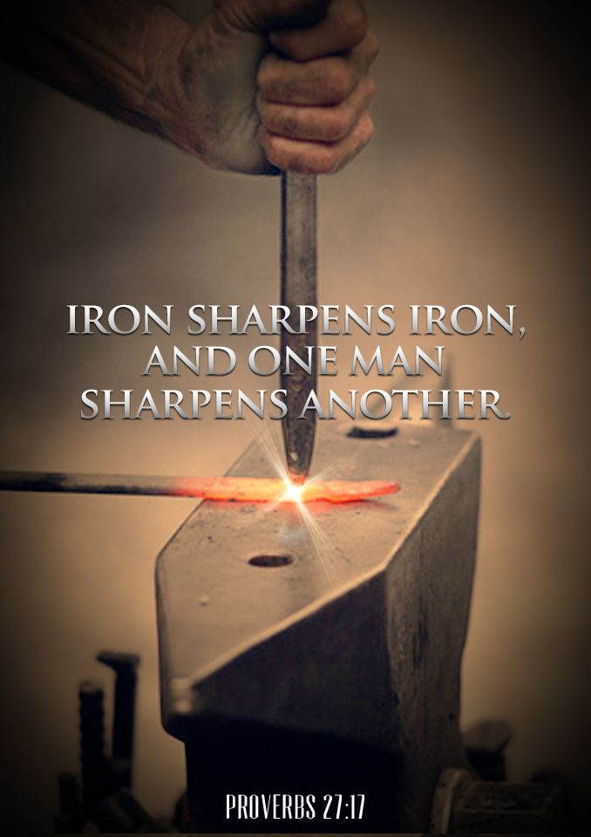
Mt. ZION MISSIONARY BAPTIST CHURCH
Iron Sharpens Iron (Proverbs 27:17)
What Does It Really Mean And Look Like?
Instructor – Minister John E. Cavanaugh

Slide 2
Have you ever heard the saying, “Iron sharpens iron?” This saying can be found in Proverbs. It is popular among the Christian community being applied to friendships, marriages, and family relationships.
The concept that Solomon was sharing implied that when you commit to being around another believer, you, yourself will be refined and they will be sharpened by you. It suggests a mutually beneficial relationship.

Slide 3
In my mind, these are the friendships that come easily. These are the people that when I leave my conversation with them, I feel like we both encouraged one another and are better because we were together. But does iron actually sharpen iron?
Iron in those days contained varying amounts of impurities and was of different strengths. Sharpening is defined as the process of creating or refining a sharp edge to an appropriate shape on a tool or implement designed for cutting.

Slide 4
Sharpening is done by grinding away material on the tool with another abrasive substance harder than the tool itself. When one thing sharpens another, the substance on the sharpening surface must be harder than the material being sharpened, such as two different alloys of iron.
In other words, if we desire to be strengthened in our faith this way, we need to spend intentional time with that type of person and spend time becoming that kind of person. It is important to ask, “Am I investing in others who live in a way that I want to model?”

Slide 5
Christ is ultimately who we should live our lives reflecting, but it is true that we become like the people we surround ourselves with regularly. This verse helped anchor me in friendships. Now that I am married, my wife is probably the most effective iron in my life.
What Does Iron Sharpens Iron Mean?
The concept of “iron sharpening iron” obviously implies at least two pieces of iron. It would be impossible for one tool to become sharper without the presence of the other. Left alone, both blades would be dull and quite useless.

Slide 6
During the time of COVID and isolation, people around the world felt lonelier than ever. Many churches were unable to meet in person and their congregants were suffering. Pastors and leaders of ministries were having to make difficult decisions that affected those in their care. However, we were created for community and it is vital that we reach out and continue relationship building during trials.

Slide 7
Genesis 2:18: “The Lord God said, "It is not good for the man to be alone. I will make a helper suitable for him." God the Father Himself has lived in community with Jesus and the Holy Spirit since before the beginning of time. They all have perfect unity.
We were created in their image and are blessed when we choose to model their emphasis on relationships with others.
It is important, when trying to understand the meaning of a Bible verse, to look at the entire passage surrounding it. The challenge with Proverbs is that at first glance, the chapters appear to be a conglomeration of random advice put together.

Slide 8
Proverbs 27 encompasses greater themes of community, authenticity, and provision.
Proverbs 27:4-5: “Better is open rebuke than hidden love. Wounds from a friend can be trusted, but an enemy multiplies kisses.”
Proverbs 27:10-11: “Do not forsake your friend or a friend of your family, and do not go to your relative’s house when disaster strikes you— better a neighbor nearby than a relative far away. Be wise, my son, and bring joy to my heart; then I can answer anyone who treats me with contempt.

Slide 9
Proverbs 27:15-16: “A quarrelsome wife is like the dripping of a leaky roof in a rainstorm; restraining her is like restraining the wind or grasping oil with the hand.”
These are just a few verses leading up to iron sharpens iron in verse 17.
Proverbs 27 is teaching the value of honest relationships that ultimately help us become more like Christ. Solomon shared about finding authentic friendships, dealing delicately with friend and family struggles, and the dangers of a wife who picks fights. I believe friendship, family, and marriage are three of the key areas that can sharpen us the most.

Slide 10
What Does Iron Sharpening Iron Look Like?
"Iron sharpening iron" refers to the process of individuals or groups mutually influencing each other through constructive criticism, healthy competition or challenging interactions.

Slide 11
Here are some aspects of what it looks like:
Mutual Growth: Individuals or groups engage in interactions that promote personal and collective growth. This can involve sharing knowledge, skills, and experiences.
Constructive Criticism: Friends or family offer feedback and criticism with the intention of helping each other improve. The emphasis is on constructive input that leads to positive changes rather than criticism for its own sake.

Slide 12
Proverbs 16:28: "A dishonest man spreads strife, and a whisperer separates close friends."

Slide 13
Challenge and Accountability: Fellowship challenges us to set higher standards and goals. There is a sense of mutual accountability where each person encourages the other to strive for excellence.
Collaboration: The process often involves collaboration and teamwork. People come together to combine their strengths and address challenges collectively.
Inspiration: Observing the achievements and progress of others can serve as motivation for personal improvement. This inspiration can lead individuals to push their boundaries and aim for higher levels of success.

Slide 14
1 Thessalonians 5:11: "Therefore encourage one another and build one another up, just as you are doing."

Slide 15
Healthy Competition: A competitive environment can push individuals to excel. When competition is healthy and supportive, it encourages participants to continuously improve without fostering negativity.
Resilience Building: Facing challenges and overcoming obstacles together builds resilience. It helps individuals develop the mental and emotional strength needed to persevere through difficulties.
Atmosphere Positive: The overall atmosphere is one of support and encouragement rather than negativity. Christians feel empowered rather than demoralized.

Slide 16
1 Corinthians 15:33: "Do not be deceived: “Bad company ruins good morals.”

Slide 17
A Quick Look At Iron in Scripture
There are plenty of other places in Scripture that mention the word iron. Many times iron is simply referring to an element used in building structures and craftsmanship (Genesis 4:22, Numbers 31:22, Joshua 22:8).
In the Old Testament, tools made of iron were not to be used on the stone altars (Deuteronomy 27:5, Joshua 8:31). The Caananites were known to have chariots of iron (Joshua 17:16-18, Judges 1:19, & Judges 4:3). Iron was even used in the building of the temple during the time of Solomon (1 Chronicles 22:14, 22:16, & 29:2)

Slide 18
Iron also represented prison chains and jail cells (Psalm 149:8, Proverbs 27:17, and Isaiah 45:2).
Notice too that iron can be used as a weapon in Scripture.
Numbers 35:16: “If anyone strikes someone a fatal blow with an iron object, that person is a murderer; the murderer is to be put to death.” When we think about iron as a weapon, we can relate that to our sharpening of others. Our honesty and trust can be used to hurt and break others down if we are not careful. In any relationship, the words we choose and our actions have an effect on the other person. In other words, it is vital to sharpen but not to stab each other.

