Slide 1
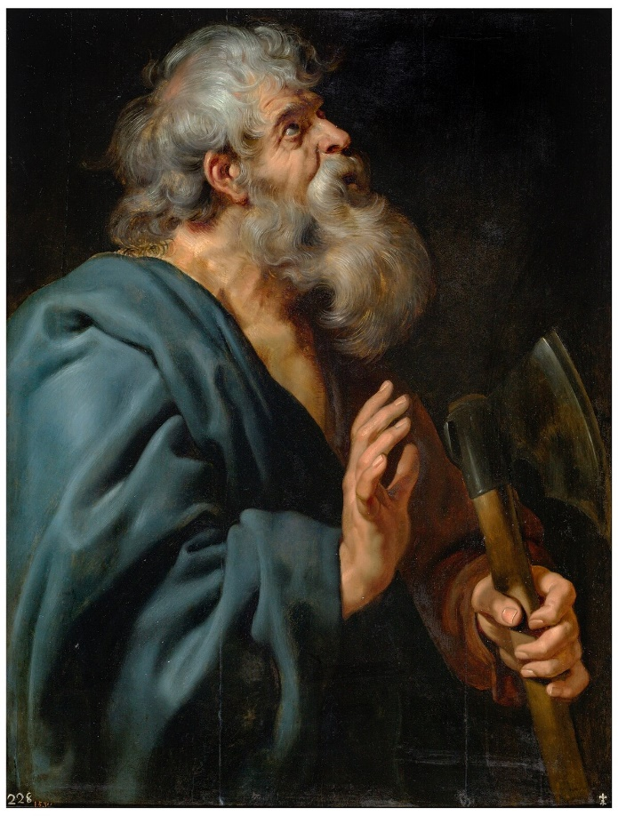
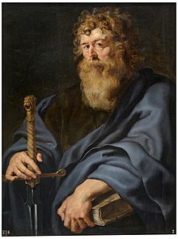
Mt Zion Baptist Church
Bible Study
Theme: Who Was The Twelfth Apostle?
Acts 1:15-26
February 19, 2025
Matthias or Paul
Notes:
NOTE:
To change the image on this slide, select the picture and delete it. Then click the Pictures icon in the placeholder to insert your own image.

Slide 2
Scripture Text
Acts 1:15-26
¹⁵ And in those days Peter stood up in the midst of the disciples, and said, (the number of names together were about an hundred and twenty,)
¹⁶ Men and brethren, this scripture must needs have been fulfilled, which the Holy Ghost by the mouth of David spake before concerning Judas, which was guide to them that took Jesus.
¹⁷ For he was numbered with us, and had obtained part of this ministry.

Slide 3
Scripture Text
Acts 1:15-26
¹⁸ Now this man purchased a field with the reward of iniquity; and falling headlong, he burst asunder in the midst, and all his bowels gushed out.
¹⁹ And it was known unto all the dwellers at Jerusalem; insomuch as that field is called in their proper tongue, Aceldama, that is to say, The field of blood.
²⁰ For it is written in the book of Psalms, Let his habitation be desolate, and let no man dwell therein: and his bishoprick let another take.

Slide 4
Scripture Text
Acts 1:15-26
²¹ Wherefore of these men which have companied with us all the time that the Lord Jesus went in and out among us,
²² Beginning from the baptism of John, unto that same day that he was taken up from us, must one be ordained to be a witness with us of his resurrection.
²³ And they appointed two, Joseph called Barsabbas, who was surnamed Justus, and Matthias.

Slide 5
Scripture Text
Acts 1:15-26
²⁴ And they prayed, and said, Thou, Lord, which knowest the hearts of all men, shew whether of these two thou hast chosen,
²⁵ That he may take part of this ministry and apostleship, from which Judas by transgression fell, that he might go to his own place.
²⁶ And they gave forth their lots; and the lot fell upon Matthias; and he was numbered with the eleven apostles.

Slide 6
Lesson Background
After the Lord’s ascension into heaven, the eleven disciples remained in Jerusalem (along with 120 others) to wait for the promise of the Father.
At some point, Peter suggested that a replacement disciple was needed to fill the position vacated by Judas
Peter came to that the conclusion based on Old Testament scripture prophecy that a close companion of the Messiah would betray Him and that someone else would take that companion’s place
Read Psalm 41:9 and Psalm 109:8

Slide 7
Lesson Background
The other disciples agreed, and determined that the replacement would have to be one who followed Jesus from the time of His baptism by John until the Lord ascended into heaven
Two men were identified for consideration, Joseph Justus called Barsabbas, and Matthias
The disciples then prayed for the Lord’s guidance in the decision and cast lots to determine God’s Will, which fell on Matthias
From that time on, Matthias was an apostle

Slide 8
Lesson Background
The selection of Matthias was the first official act of the Apostles without Jesus’ physical presence and because the Lord wasn’t there, some today question Matthias being an apostle.
People who question Matthias’ apostleship point to the call of Paul by Jesus on the Damascus Road as the Lord’s personal selection of Judas’ replacement
Read Acts 9:15
Therefore, it is clear in the Savior’s own words that Paul was definitely chosen to be an apostle
But does Paul’s apostleship cancel out Matthias’ apostleship?

Slide 9
Who Was Matthias?
Who Was Matthias?
The Bible only mentions Matthias by name in Acts 1
Based on Peter’s statement that only those who had been with Jesus throughout His earthly ministry would be considered to replace Judas, we know that Matthias must have been one of the 70 disciples mentioned in Luke 10:1
Even today, there are groups that recognize Matthias’ apostleship and annually honor his ministry. In the west, Matthias’ life is celebrated on May 14; in some Anglican church on February 24; in the Orthodox church on August 9

Slide 10
What Is An Apostle?
What Is An Apostle?
The word apostle comes from a Greek word that means one who is sent. In other words, one who is entrusted with a mission. The Bible contains three usages of the word apostle:
Read Hebrews 3:1.
Jesus is the Great Apostle who was sent by the Father to redeem the world
Read Acts 14:14 and Galatians 1:19
These verses use apostle to refer to men who were not of the original 12 disciples but were prominent in the spread of the Gospel

Slide 11
What Is An Apostle?
What Is An Apostle?
The third and most common usage of apostle refers to the disciples whom Jesus selected to be His chief witnesses
If Matthias were to be considered an apostle like Peter and the other disciples, he would have to meet the same criteria they did, namely:
  The need for an apostle must be aligned with Scripture
  The candidate must be a faithful follower of Christ
  The candidate must receive a legitimate call into the ministry
  The candidate must fulfill the role of an apostle

Slide 12
Apostolic Criteria
Alignment with Scripture
When Peter suggested that a replacement disciple was needed, he understood that the selection must align with Scripture
Acts 1:20 says “For it is written in the book of Psalms, Let his habitation be desolate, and let no man dwell therein; and his bishoprick let another take.”
This reference revealed to Peter that the Scripture placed great significance on there being twelve apostles and that Judas had to be replaced

Slide 13
Apostolic Criteria
Alignment with Scripture
The number 12 was significant to the Jewish nation, for example there were 12 tribes in the nation of Israel
Read Revelation 21:14
Therefore, the Lord intended to have twelve apostles, opening the door for Matthias to be an apostle

Slide 14
Apostolic Criteria
Faithful Follower of Christ
Acts 1:22 says “Beginning from the baptism of John, unto that same day that he was taken up from us, must one be ordained to be a witness with us of his resurrection.”
The replacement apostle had to be someone who had faithfully followed Jesus throughout His earthly ministry and was taught by Him
Jesus also placed emphasis on His apostles being faithful followers
Read Matthew 19:28 and John 6:60-66
So Matthias must have followed the Lord when others left

Slide 15
Apostolic Criteria
Legitimate Call into the Ministry
While Matthias was not personally called by Jesus like the other apostles, there is evidence that God did approve of him
Read Acts 1:24
This indicates that the Matthias was not chosen haphazardly and that the disciples sought the Lord’s guidance
The disciples then “cast lots” to identify the replacement. Casting lots was used in the Old Testament to indicate God’s Will
Read Jonah 1:7

Slide 16
Apostolic Criteria
Legitimate Call into the Ministry
Therefore, it is not inconceivable that casting lots may have revealed God’s call of Matthias as Judas’ replacement
The final evidence of Matthias’ legitimate call is the fact that God does not reveal His disapproval of him
In Acts 6:1-2, when the Grecians were murmuring that their widows were being overlooked in the distribution of food, the Scripture said that the twelve called the people together.
This implies that Matthias was commonly recognized as an apostle

Slide 17
Apostolic Criteria
Fulfillment of the Office of an Apostle
There are 3 unique qualities that apostles possess
  They perform outstanding, complete miracles
  They are very sound expository preachers
  They have a connection with the wounds of Christ and partake in His sufferings
Because Matthias was only briefly mentioned in Acts 1, the Bible does not provide any evidence of the first two qualities
The only quality he could have had was to have witnessed the wounds, death, and resurrection of Jesus

Slide 18
Apostolic Criteria
Fulfillment of the Office of an Apostle
But the fact that we know of no miracles nor sermons performed by Matthias is not grounds for his disqualification as an apostle
The New Testament only mentions two apostles that performed miracles (Peter and John) and only Peter is recorded as delivering a sermon
So, Matthias’ biblically recorded credentials are equal to most of the other disciples.

Slide 19
Apostolic Criteria
Fulfillment of the Office of an Apostle
As the research for this lesson, I found an essay entitled, “Who Was the 12th Apostle?” which suggested that Matthias was the source from which the synoptic gospels received much of their information based on the following:
  The Gospel of Matthew is attributed to Matthew the tax collector but there is not evidence that the tax collector wrote it
  The name Matthias is the Greek version of Matthew
  The perspective of the Gospel of Matthew is written from the outside looking in, not from one of the Inner Twelve

Slide 20
Apostolic Criteria
Fulfillment of the Office of an Apostle
As the research for this lesson, I found an essay entitled, “Who Was the 12th Apostle?” which suggested that Matthias was the source from which the synoptic gospels received much of their information based on the following:
  In Matthew 9:9 – “And as Jesus passed forth from thence, He saw a man, named Matthew…” This is an unusual way to refer to oneself
  If Matthias had a written record of the life of Jesus, that made him an excellent candidate for the replacement of Judas and therefore God caused the lot to fall on Matthias.
While Scripture DOES NOT substantiate any of the above claims, it was worth discussing here.

Slide 21
Conclusion
Conclusion
While most people either reject or are unaware of the apostleship of Matthias, there is good evidence to suggestion otherwise
  He fulfilled the apostolic criteria
  He was a faithful follower of Jesus throughout His ministry
  He received a legitimate call to the ministry
  He fulfilled the office of an apostle

Slide 22
Conclusion
Conclusion
But what does this say about the apostleship of Paul?
Nothing!
Matthias was an apostle to the Jews, while Paul was an apostle to the Gentiles
Read Acts 10:13-15
So that the Gospel would not be hindered by those who struggled to share it with Gentiles, God called a 13th apostle, Paul

Slide 23

Questions

Slide 24


Thank You and God Bless You

